Slide 1
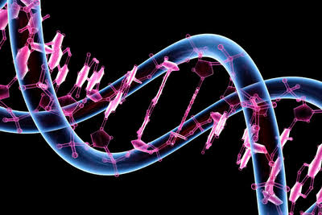
WELCOME

Slide 2
SEX CHROMOSOMAL ABNORMALITIES IN MAN Alka E.Varghese Assistant Professor in Botany

Slide 3
1.Turner’s syndrome
Sexual abnormality in females
Discovered by Turner in 1938
It is caused due to the absence of one of the X – chromosome (45 with XO)
The karyotype of these patients shows 45 chromosome in the cell of a person
It is caused by of XX chromosomes
There is only one X – chromosome and no Y- chromosome (44A+ XO= 45)

Slide 4
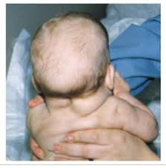
The characteristics of the Turner’s syndrome are following
1.Underdeveloped feminine character
2.Lack of secondary sexual characters
3.Short stature
4.Rudimentary ovaries
5.Poorly- developed breasts
6.Webbed –neck
7.Subnormal intelligence
8.Mental retardation

Slide 5
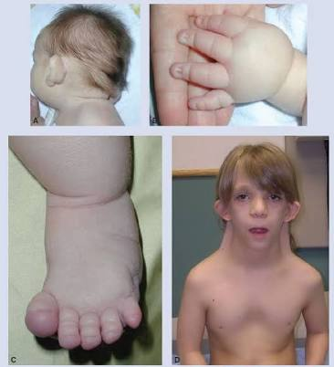

Slide 6
2.Klinefelter’s syndrome
It was discovered by Harry in 1922
The genetic disorder is caused by an additional copy of X- chromosome resulting into karyotype 47, XXY
The karyotype of these patients shows 47 chromosomes
It is caused by trisomy (44A +XXY =47)
It is caused by non-disjunction of XX chromosome
Though the individual is male , he shows a number of feminised characters

Slide 7
The symptoms of Klinefelter’s syndrome are the following
1.Tall stature with feminised character (physique)
2.Sterile males
3.Mental retardation

Slide 8
HAEMOPHILIA
It was discovered by John cotto in 1803
The factor responsible for blood clotting is anti-haemophilic globulin
This factor is absent in patient suffering from haemophilia
Even minor injuries can cause death due to excessive bleeding ( Bleeder’s disease)

Slide 9
As it is common in royal families of Europe and Queen Victoria
Haemophilia is also said to be royal disease
The family pedigree of Queen Victoria shows a number of haemophilic descendents as she was carrier of the disease

Slide 10
Haemophilia is an example of inherited disease
The gene responsible for haemophila is in X –chromosome
The Y-chromosome carries no gene for this trait
Haemophilia is caused by a recessive gene ‘h’ and normal clotting is due to dominant gene ‘H’

Slide 11
Since females have two X- chromosomes , they may be of the genotype ‘HH’ or ‘Hh’ or ‘hh’
Homozygous dominant female (HH) are normal
Hetrozygous female (Hh) will not have haemophilic since ‘H’ is dominant over ‘h’.
But ,they may transmit the haemophilia to their sons

Slide 12
So , hetrozygous females are called carriers
Homozygous recessive females (hh) will be haemophilic
When a normal woman (HH) happens to marry a haemophilic man (h), all their daughters are carriers of disease because they are heterozygous (Hh)
They receive a dominant gene ‘H’ from mother and ‘h’ from father

Slide 13
All the sons are normal because they receive the X-chromosome with normal gene from the mother and the y-chromosome from the father . Which contains no gene for this trait
When the daughter (carrier) is married to a normal man , 50% of the sons will be normal and 50% daughters will be haemophilic . While 50% of daughters will be normal and the remaining 50 % will be the carriers of disease

Slide 14
Since haemophilia is transmitted from the father to the grandson through the daughter; the inheritance is said to be criss –cross inheritance or zig –zag inheritance

Slide 15
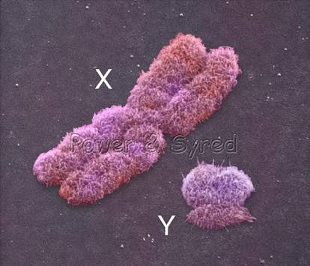
SEX LINKED INHERITANCE

Slide 16
CHARACTERISTICS OF SEX LINKED INHERITANCE

Slide 17
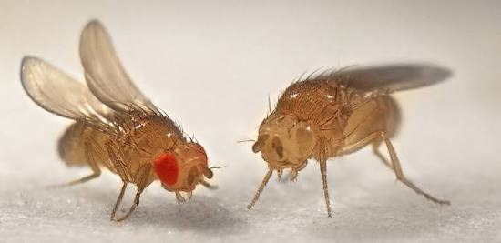
CRISS CROSS INHERITANCE
EYE COLOUR IN DROSOPHILA

Slide 18
CRISS CROSS INHERITANCE

Slide 19
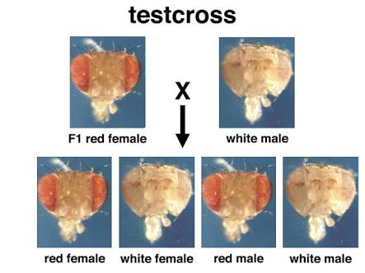
RECIPROCAL CROSSES

Slide 20
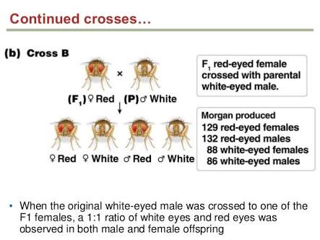

Slide 21
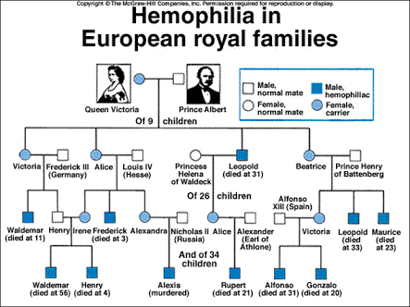
PEDIGREE CHART – HAEMOPHILIA GENE

Slide 22
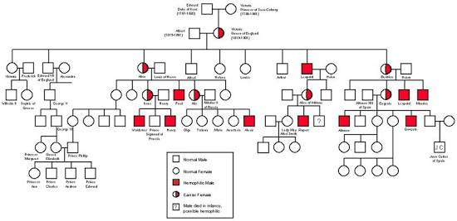

Slide 23
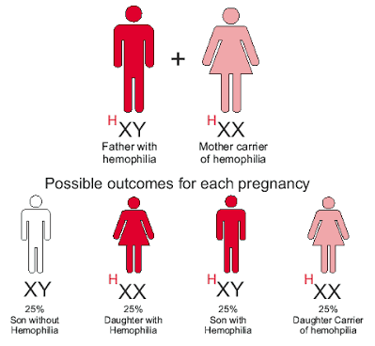
PATTERN OF INHERITANCE

Slide 25
HYPERTRICHOSIS

Slide 26
