Slide 1
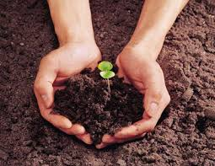
Soil Pollution
Fancy D.R
Assistant Professor
Department of English
Christian College
Chengannur

Slide 2
SOIL POLLUTION
Soil pollution is defined as the build-up in soils of persistent toxic compounds, chemicals, salts, radioactive materials, or disease causing agents, which have adverse effects on plant growth and animal health.

Slide 3
Causes of Soil Pollution
Seepage from a landfill
Discharge of industrial waste and e-waste into the soil
Percolation of contaminated water into the soil
Rupture of underground storage tanks
Excess application of pesticides, herbicides or fertilizer (agrochemicals)
Solid waste seepage

Slide 4
Waste materials can be broadly divided into three categories:
Municipal solid wastes (ie. from homes, hotels etc.)
Special wastes (medical waste, construction debris, asbestos, mining waste, agricultural waste, radioactive waste, sewage sludge)
Hazardous wastes : Waste with properties that make it capable of harming human health or the environment. eg. Electroplating wastes, spent solvents, heavy metals in e- waste, wood processing wastes.

Slide 5
Solid wastes
Any non liquid, non- soluble materials ranging from municipal garbage to industrial wastes that contain complex and sometimes hazardous substances.
It include;
Garbage
Rubbish
Demolition wastes
Sewage treatment residue
Dead animals
Manure and other discarded materials.

Slide 6
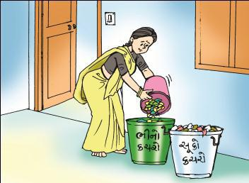
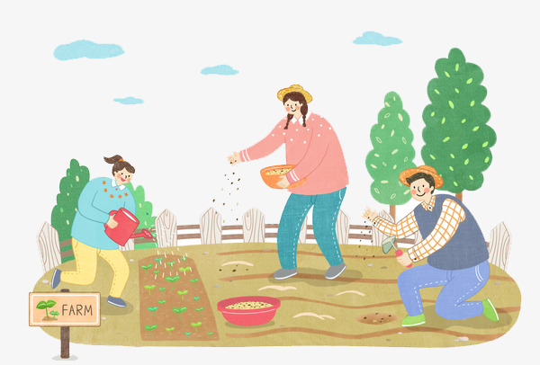
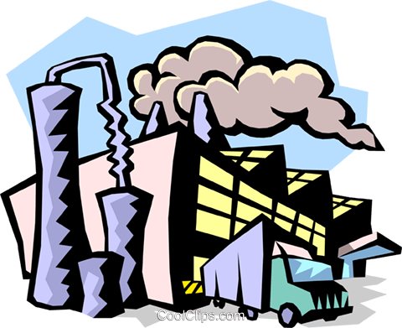
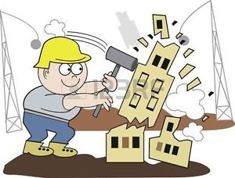
Sources of solid wastes
HOUSE HOLDS
AGRICULTURE
INDUSTRY
CONSTRUCTION
INSTITUTION S

Slide 7
Solid waste management “3rs”

Slide 8
Electronic waste (E-waste)
Among top ten cities generating e-waste, Mumbai ranks first followed by Delhi, Bangalore, Chennai, Kolkata, Ahmedabad, Hyderabad, Pune, Surat and Nagpur.

Slide 9
Composition of E-waste
Composition of E-waste is very diverse and differs in products across different categories. It contains more than 1000 different substances, which fall under “hazardous” and “non-hazardous” categories.
Broadly, it consists of ferrous and nonferrous metals, plastics, glass, wood & plywood, printed circuit boards, concrete and ceramics, rubber and other items. Iron and steel constitutes about 50% of the e-waste followed by plastics (21%), non ferrous metals (13%) and other constituents.
Non-ferrous metals consist of metals like copper, aluminium and precious metals eg. silver, gold, platinum, palladium etc.

Slide 10
Radioactive wastes
Radioactive wastes are wastes that contain radioactive material. Radioactive wastes are usually by-products of nuclear power generation and other applications of nuclear fission or nuclear technology, such as research and medicine.
Radioactive waste is hazardous to most forms of life and the environment, and is regulated by government agencies in order to protect human health and the environment.

Slide 11
Health effects
Contaminated or polluted soil directly affects human health through direct contact with soil or via inhalation of soil contaminants which have vaporized; potentially greater threats are posed by the infiltration of soil contamination into groundwater aquifers used for human consumption, sometimes in areas apparently far removed from any apparent source of above ground contamination.
Health consequences from exposure to soil contamination vary greatly depending on pollutant type, pathway of attack and vulnerability of the exposed population.

Slide 12
Bioaccumulation
Soil pollution can harm humans by bioaccumulation.
Plants that are grown in lightly polluted soil continuously absorb molecules of the pollutants. Since the plants cannot get rid of these molecules, they accumulate in the plant, causing higher amounts of pollution to exist in the plant than in the soil.
Animals who eat many of these polluted plants take on all the pollution those plants have accumulated. Larger animals who eat the plant-eating animals take on all the pollution from the animals they eat.
Humans who eat plants or animals that have accumulated large amounts of soil pollutants may be poisoned, even if the soil itself does not contain enough pollution to harm human health.

Slide 13
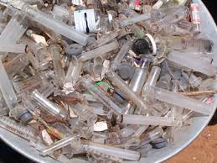
Health risks of Medical wastes

Slide 14
Medical wastes include items that are generated from health care treatment or research facilities and that can come in contact with body fluids or other material that may contain infectious or disease causing agents.
Eg. Soiled or blood soaked bandages.
Culture dishes or other associated glassware.
Gloves, gowns, scalpels, and other items used during
surgery.
Needles used to give injections or draw blood
Body fluids and tissues.
The predominant health risk associated with medical waste is the presence of infectious pathological organisms.
Accidental skin puncture from hypodermic needles and other sharps (hepatitis B, C viruses and HIV).

Slide 15
ECONOMIC LOSSES
In addition to endangering human health, soil pollution can also cause economic damage.
For example, in some parts of China, soil that is polluted with heavy metals is nevertheless used to grow grain. The grain grown in these soils is often polluted with heavy metals.

Slide 16
Reducing chemical fertilizer and pesticide use.
Applying bio-fertilizers and manures .
Biological methods of pest control.

Slide 17
Solid Waste Management
Reusing of materials: Materials such as glass containers, plastic bags, paper, cloth etc. can be reused at domestic levels rather than being disposed, reducing solid waste pollution.

Slide 18
Recycling and recovery of materials
This is a reasonable solution for reducing soil pollution. Materials such as paper, some kinds of plastics, e-waste and glass can and are being recycled. This decreases the volume of refuse and helps in the conservation of natural resources.
For example, recovery of one ton of paper can save 17 trees.

Slide 19
Reforesting
Control of land loss and soil erosion can be attempted through restoring forest and grass cover to check wastelands, soil erosion and floods.
Crop rotation or mixed cropping can improve the fertility of the land.

Slide 20
Soil Remediation
Physical remediation : is the process of correcting the problems by physical means.
eg. Evacuation and dredging pollutes sites of soils and disposing them on landfills.
Chemical remediation: is correcting the soil from pollutant by chemical means.
eg. Reclamation of soils contaminated by mine spoil.

Slide 21
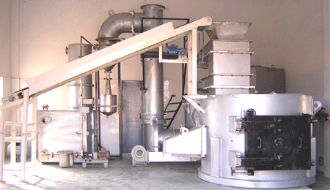
Incinerator with automatic waste feeder and wet venturi scrubber

Slide 22
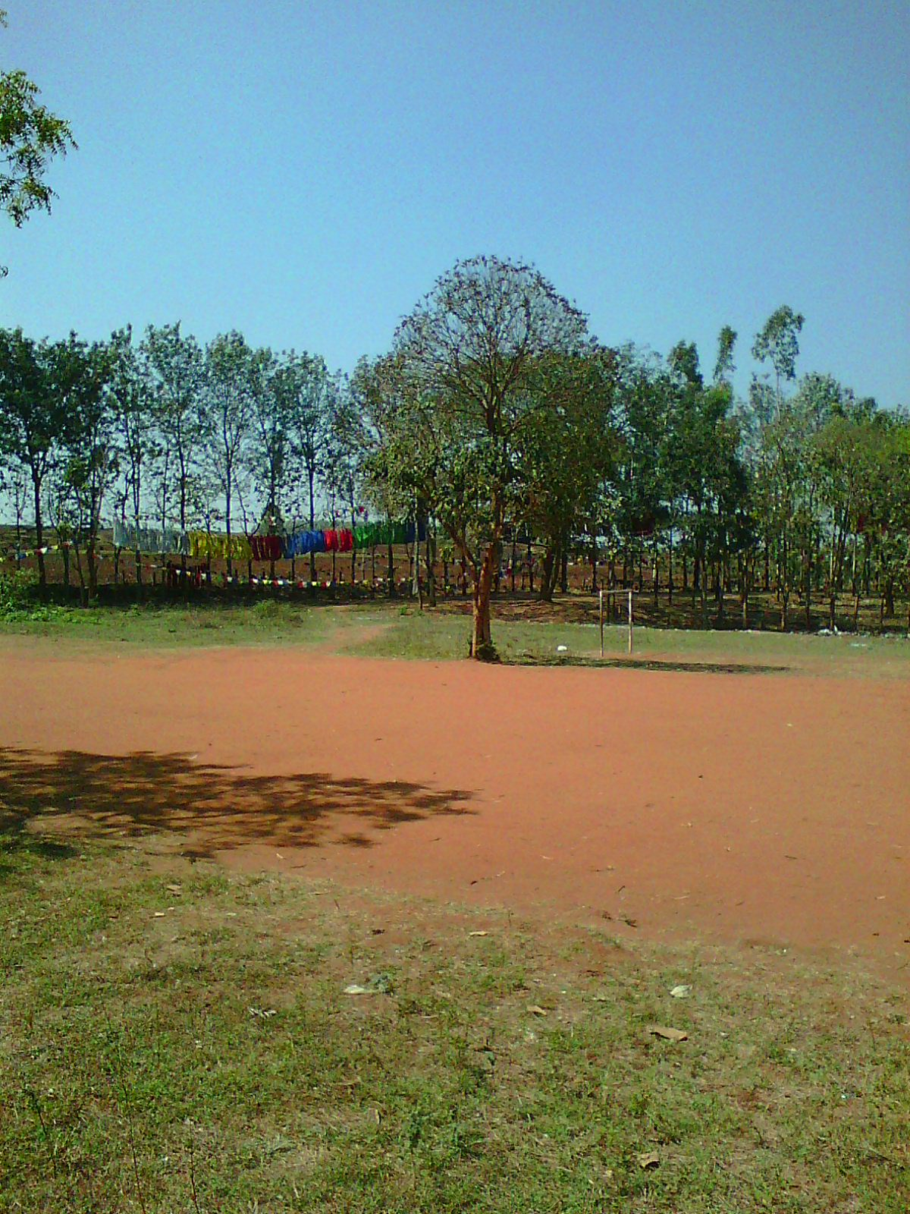
THANK YOU

