Slide 1
TOOLS FOR MEASURING NANOSTRUCTURE
Rekha Unni Assistant Professor in Chemistry Christian College Chengannur

Slide 2
TOOLS FOR MEASURING NANOSTRUCTURE

Slide 3
X-RAY DIFFRACTION (XRD)
These analytical techniques reveal information about the crystallographic structure, size, chemical composition and physical properties.
Based on observing the scattering intensity of an X-ray beam hitting a sample as a function of incident and scattered angle , polarization and wavelength or energy.
X-ray diffraction has been applied to different types of applications including thin film analysis ,sample texture evaluation etc…

Slide 4
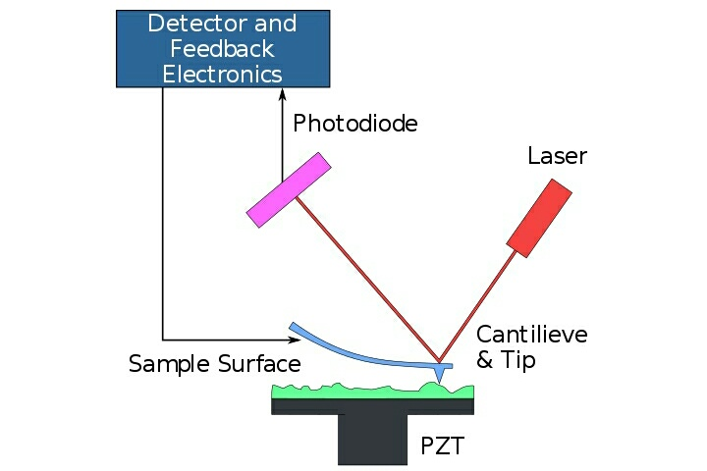
ATOMIC FORCE MICROSCOPY(AFM)/ SCANNING FORCE MICROSCOPY(SFM)
The AFM is one of the foremost tools for imaging , measuring and manipulating matter at nanoscale.
AFM is commonly operated in two modes-the contact mode and the non contact or tapping or intermittent mode
Contact mode-The tip comes in contact with the surface . The force between the sample and tip is the product of the displacement of the tip and the force constant of the cantilever.
Non contact mode-The tip is oscillated at its resonant frequency by an actuator
The AFM is one of the foremost tools for imaging , measuring and manipulating matter at nanoscale.
AFM is commonly operated in two modes the contact mode and the non contact or tapping or intermittent contact mode

Slide 5
ADVANTAGES AND DISADVANTAGES OF AFM
ADVANTAGES
DISADVANTAGES
Easy sample preparation
Accurate height information
Living systems can be studied
3-D imaging
Surface roughness quantification
Limited vertical range
Limited magnification range
Data not independent of tip
Tip or sample can be damaged
Limited scanning speed

Slide 6
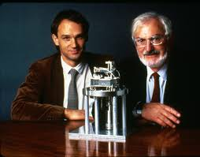
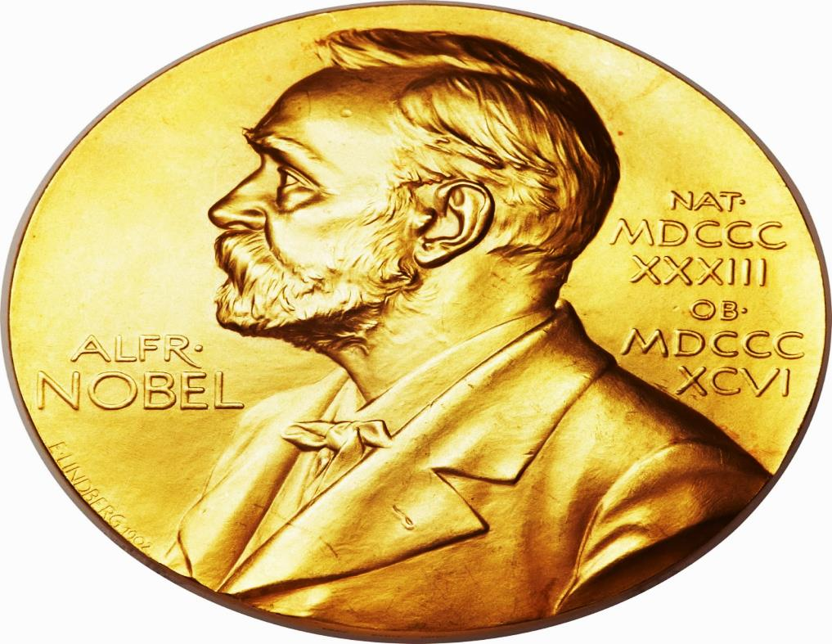
SCANNING TUNNELING MICROSCOPE(STM)
A scanning tunneling microscope is an instrument for imaging surfaces at the atomic level.
Its development earned its inventors, GERD BINNING and HEINRICH ROHRER the Nobel prize in physics in 1986.
GERD BINNING & HEINRICH ROHRER
The STM can not be used only in ultra high vacuum but also in air , water and various other liquid or gases

Slide 7
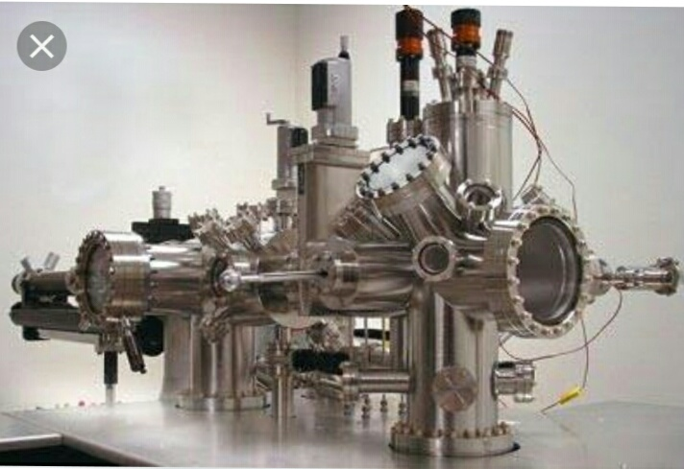
The STM is based on the concept of quantum tunneling
STM requires extremely clean and stable surfaces , sharp tips ,excellent vibration control and sophisticated electrons.
SCANNING TUNNELING MICROSCOPE
The magnification capabilities of the STM is due to the flow of tunneling current through the small gap that separates the tip from the sample
Tunneling current can be better explained by quantum mechanics rather than classical mechanics

Slide 8
TUNNELING CURRENT
When a potential difference is applied between sample and tip the tunneling phenomena results in a net electric current , the TUNNELING CURRENT
TUNNELING CURRENT exhibits an exponential decay with an increase on the gap “d”
where K and k are constants
U is the tunneling bias
I=KU$e^{−kd}$

Slide 9
MERITS AND DEMERITS OF STM
ADVANTAGES
DISADVANTAGES
STMs are versatile. They can be used in ultra vacuum, air ,water and other liquids and gasses.
STM gives three dimensional profile of a surface , which allows researchers to examine a multitude of characteristics, including roughness, surface defects and molecule size.
Lateral resolution of 0.1 nm of resolution in depth can be achieved.
It is very expensive.
It need specific training to operate effectively.
STM need very clean surface , excellent vibration control while operation, single atom tip.

Slide 10
ELECTRON MICROSCOPE (EM)
It is a type of microscope that uses a beam of electrons to create an image of the specimen
Electron microscope have a greater resolving power than a light powered optical microscope because electrons have wavelengths about 100,000 times shorter than photons
Electromagnetic or electrostatic lenses are used to control the path of electrons
Electromagnetic lens is designed as a solenoid , electron beam passes through the centre of solenoid towards the sample.
TYPES OF ELECTRON MICROSCOPES
1.TRANSMISSION ELECTRON MICROSCOPE
2.SCANNING ELECTRON MICROSCOPE

Slide 11
1.TRANSMISSION ELECTRON MICROSCOPE (TEM)
TEM uses a high voltage electron beam to create an image.
The electrons are emitted by an electron gun , commonly fitted with a tungsten filament cathode as the electron source.
The electron beam is accelerated by an anode.
The spatial variation is recorded by hitting a fluorescent screen , photographic plate or light sensitive sensor such as CCD(charge coupled device) camera.
TEM produce two dimensional,
Black and white images.

Slide 12
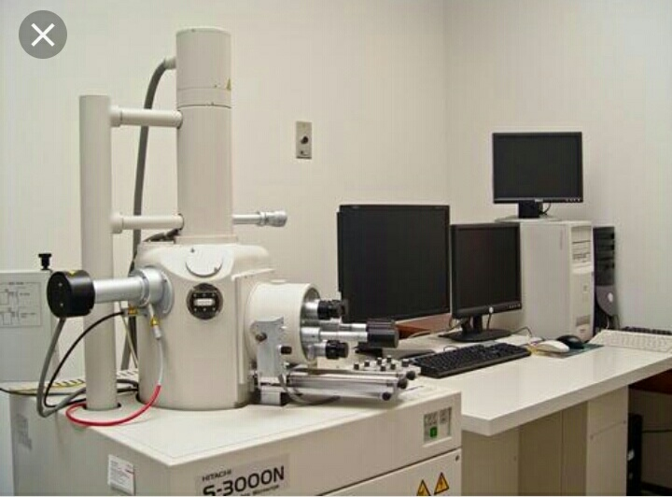
2.SCANNING ELECTRON MICROSCOPE(SEM)
Essential components of SEM include electron source , electron lenses , sample stage , detectors ,out put devices and infrastructure requirements such as power supply , cooling system etc..
The SEM produces images by detecting secondary electrons which are emitted from the surface due to excitation by the primary electron beam.
SCANNING ELECTRON MICROSCOPE
At each point on the specimen the incident electron beam loses some energy and that lost energy is converted into other forms of signals that reveal information about the sample including external morphology , chemical composition etc…

Slide 13
SEM image of a micro pollen grain

Slide 14
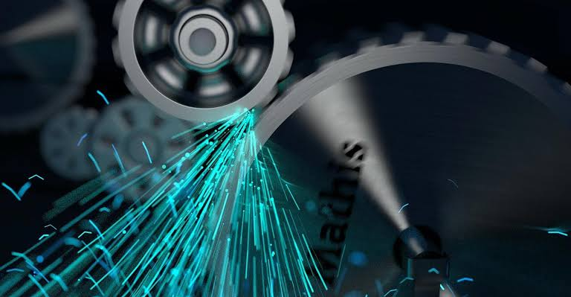
PROPERTIES OF NANOPARTICLES
OPTICAL PROPERTIES
MAGNETIC PROPERTIES
MECHANICAL PROPERTIES

Slide 15
1.OPTICAL PROPERTIES
When a metal absorbs light of a resonant wavelength it causes the electron cloud to vibrate , dissipating energy. This process usually occurs at the surface of the material and therefore called SURFACE PLASMON RESONANCE.
PLASMONS are the name for the oscillation of electron cloud.
Small nano particles absorbs light in the blue green portion while red light is reflected.
As the particle size increases , the wavelength of the surface plasmon related absorption shifts to longer , redder wavelengths.
As the particle size continues to increase towards the bulk limit,surface Plasmon resonance move into the IR portion of the spectrum and most visible wavelengths are reflected which gives nano particles a clear and translucent colour

Slide 16
2.MAGNETIC PROPERTIES
Nano particles due to their very small sizes and fundamental change in the coordination , symmetry and confinement exhibit specific properties such as paramagnetism.
Super paramagnetism has great relevance to modern potential technologies including magnetic resonance imaging contrast agents ,ferrofluid technology etc..
In sufficiently small nano particles, magnetization can randomly flip direction under the influence of temperature. The typical time between the two flips is called the NEEL RELAXATION TIME.
In the absence of external magnetic field,when the time used to measure the magnetic field is much longer than NEEL RELAXATION TIME , their magnetization appears to be average zero.

Slide 17
3.MECHANICAL PROPERTIES
The tensile strength of a material is the maximum amount of tensile stress that it can take before breaking.This maximum stress a material can withstand is known as ultimate tensile stress.
The slope of the stress strain curve , the ratio of the uniaxial stress over the uniaxial strain at any point is called the tangent modulus.
The tangent modulus of the initial linear portion of a sress-strain curve is the tensile modulus or young’s modulus which measure the stiffness of a material.
The theoretical prediction of tensile modulus for nanotubes is in the range of(1-5)Tpa.

