Slide 1
The Earth’s Atmosphere & Ionosphere
Dr. Tiju Joseph Mathew
Asst. Professor, Dept. of Physics,
Christian College, Chengannur

Slide 2
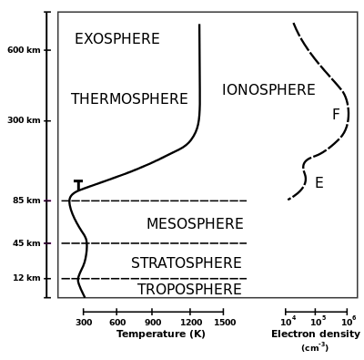
The Earth’s Atmosphere
&
Ionosphere
The Ionosphere
The ionized part of Earth's upper atmosphere.
Ionized by solar radiation.

Slide 3
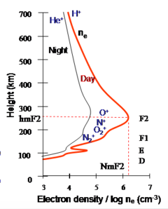
Electron Density Profile
N_{i} = N_{e} = N
Photoionization + Recombination
F – Peak at 300km

Slide 4
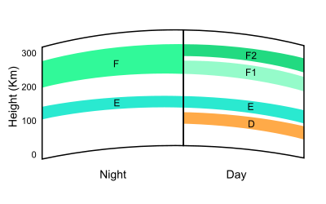
Layers of Ionosphere
D region
Region below 90 kms
Electrons and ions are controlled by magnetic field.
E region
Region between 90 – 150 kms
Ion movement is controlled by neutral wind & Electron movement by geomagnetic field.
F region
Region having highest concentration of free electrons and ions.
Ion movement and Electron movement is controlled by geomagnetic field.

Slide 5
Importance of
Ionospheric Studies
Sensitive Monitor of Atmospheric Events.
Sensitive Monitor of Solar Phenomena.
Wave guide for Radio wave Propagation

Slide 6
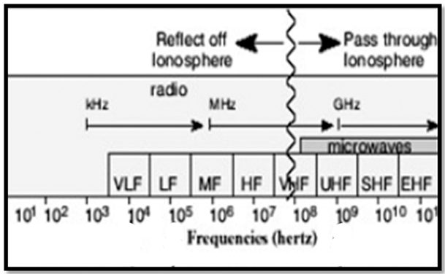
Ionospheric Effect on
Navigation System
Ground based Navigation System
Space based GPS system

Slide 7
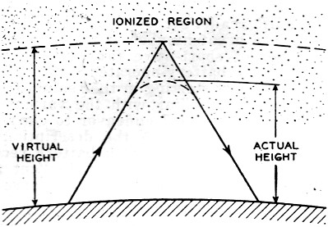
Radio Wave Refraction in Ionosphere

Slide 8
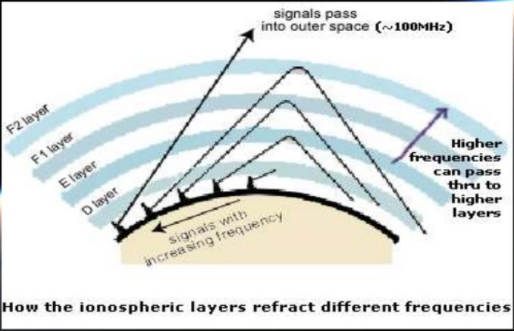
Radio Wave Refraction in Ionosphere
Critical Frequency (foF2)
Peak Height (hmF2)

Slide 9
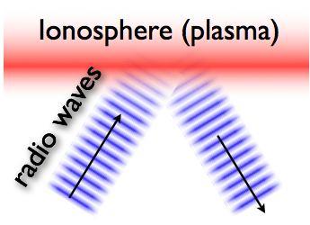
Parameters affecting the Refractive Index
Frequency of Transmitting Wave
Number Density of Electrons
The refractive index ,
A transmitted wave reflects when the
Frequency of transmitted wave = Plasma frequency
Plasma Frequency,
Vertical Ionospheric Sounding

Slide 10
Variations In Ionosphere
Regular Variations - Occurs in Cycle
Diurnal
Seasonal
Solar Cycle
Irregular Variations - Occurs Abnormally
Sudden Ionospheric Disturbances
Ionospheric Storms

Slide 11
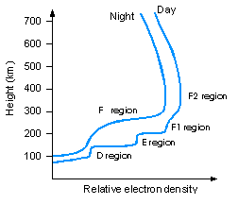
Diurnal Variation
Result of Earth’s Rotation
Night time
Photoionization Stops
Recombination Begins
D Vanishes
F1 & F2 merges together
Daytime
Photoionization Begins
F separated F1+F2

Slide 12
Thank You

