Slide 1
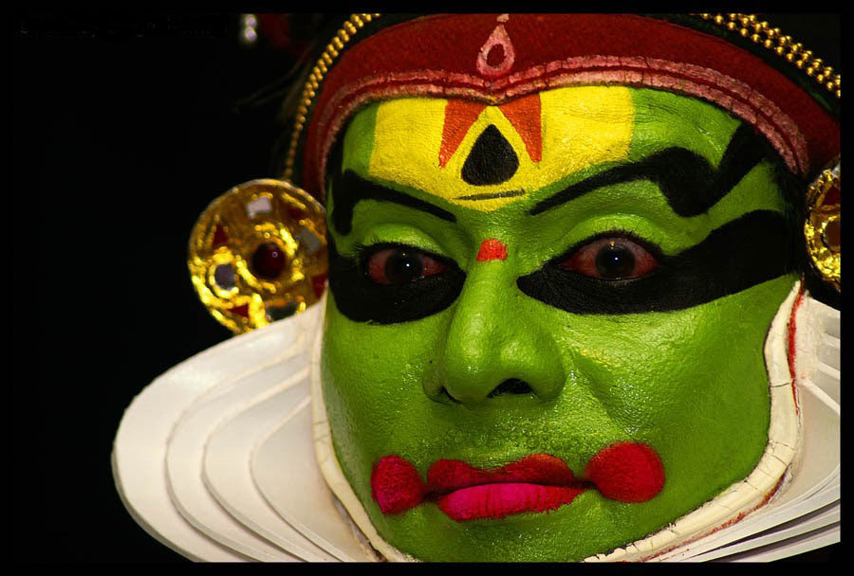
Colour symbolism in
the theatrical performance
of Nalacharitham
Aattakkatha
By,
Bindu John
Malayalam

Slide 2
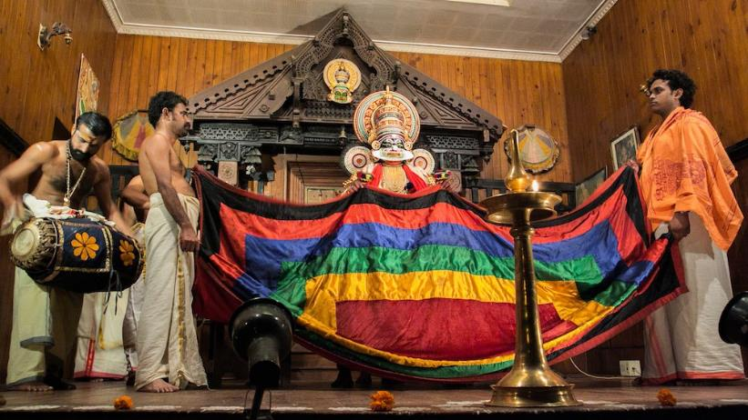
thirasheela

Slide 3
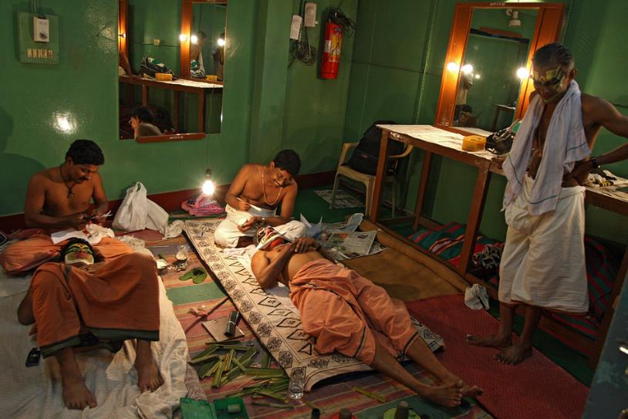
Aniyara orukkangal
mukhathezhuthu

Slide 4
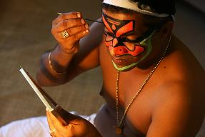
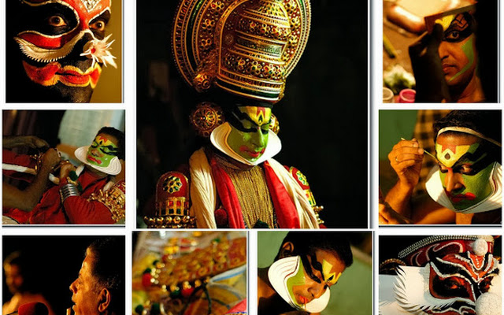
Aniyara orukkangal
Mukathezhuthu , Chuttikuthu

Slide 5
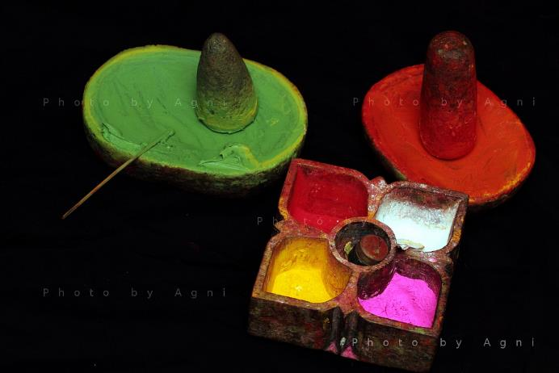
Chayilyam

Slide 6
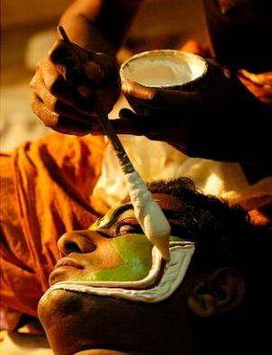
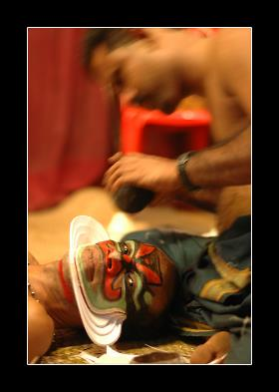
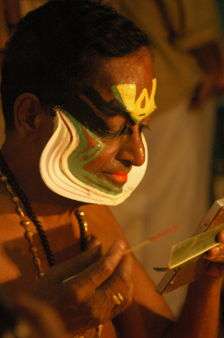
Aniyara orukkangal
Mukathezhuthu

Slide 7
Hamsam
satvikam

Slide 8
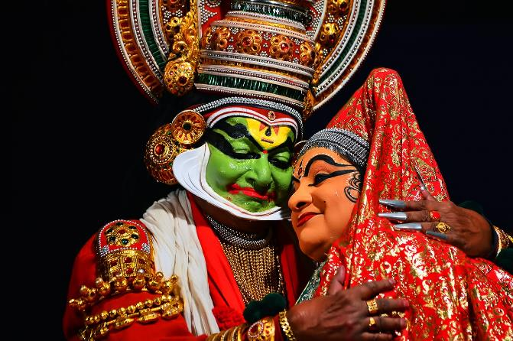
Pacha (Nalan) , Minukku (Damayanti)
satvikam

Slide 9
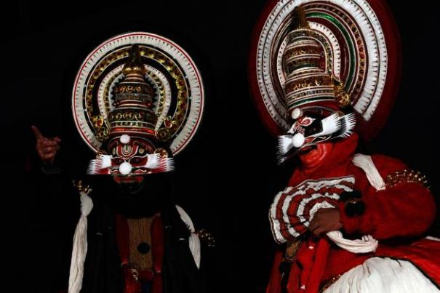
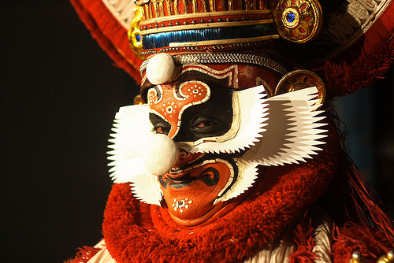
Karuthathadi( Kali), Chuvapputhadi (Dwaparan)
thamogunam

Slide 10
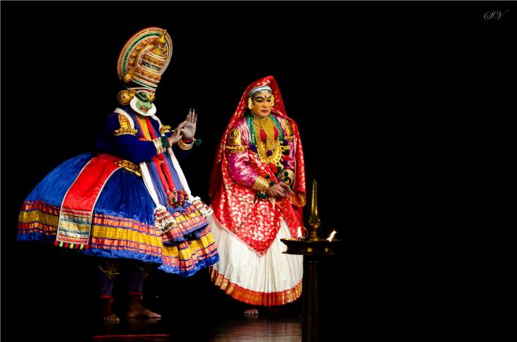
Pacha ( Bahugan) , Minukku(Damayanti)
satvikam

Slide 11
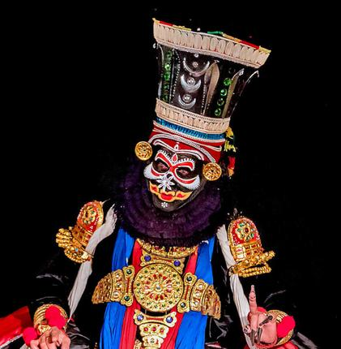
Im«m-f³
Icn-thjw

Slide 12
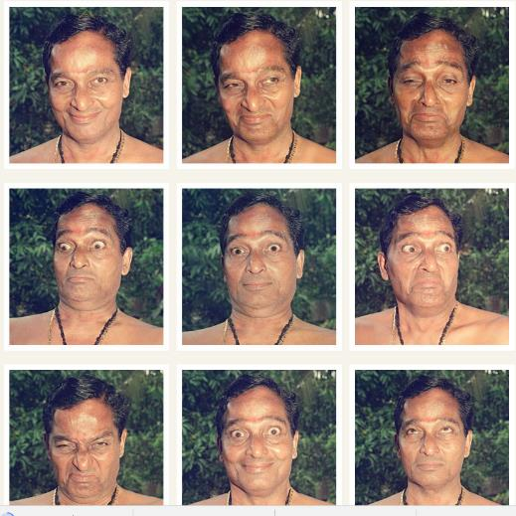
navarasangal

