Slide 1
TAXONOMY
----------------------------------------------------
Dr. Fijesh. P. Vijayan
Department of Botany
Christian College, Chengannur

Slide 2
Dicotyledons
Embryo with two cotyledons
Leaves with reticulate venation
Flowers are usually Pentamerous
Median sepal situated on posterior side, except in Leguminosae.

Slide 3
Classification
Basis
Presence or absence of perianth and its differentiation into calyx and corolla.
Subclasses
Polypetalae
Gamopetalae
Monochlamydeae

Slide 4
Sub class - Polypetalae
Characters
Calyx and corolla present
Petals free and stamens are not united into petals.
Polypetalae is subdivided into 3 series.
Thalamiflorae
Disciflorae
Calyciflorae

Slide 5
Series- I- Thalamiflorae:
Characters
Thalamus is well developed
Calyx free
Calyx and corolla in several series
Stamens definite or indefinite
Ovary superior
Flower hypogenous
The series is sub divided into 6 cohorts and 34 families.

Slide 6
Series- I- Thalamiflorae:
Cohorts and Families (for detailed study)
Cohort 1- Ranales - 8 families - Annonaceae, Nymphaceae
Cohort 2- Parietales - 9 families
Cohort 3- Polygalinae - 4 families
Cohort 4- Caryophyllineae - 4 families
Cohort 5- Guttiferales - 4 families
Cohort 6- Malvales - 3 families. - Malvaceae

Slide 7
Cohort - Ranales
Characters
Sepals coloured
Stamens and petals arranged in whorls
Stamens definite or numerous
Ovary superior
Apocarpus.

Slide 8
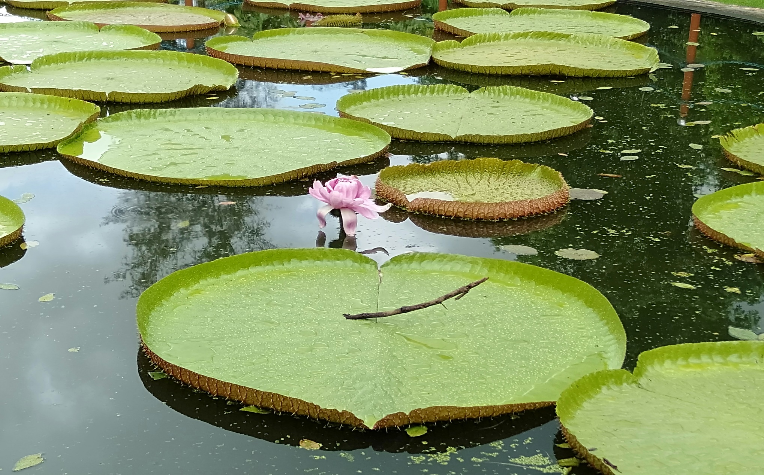
Nymphaeceae
Class - Dicotyledons
Sub class - Polypetalae
Series - Thalamiflorae
Cohort - Ranales
Victoria regia

Slide 9
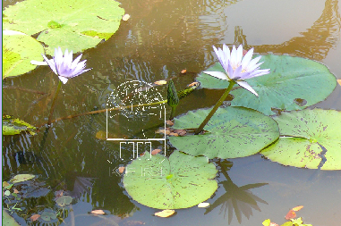
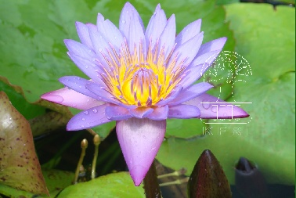
Common plants
Nymphaea caerulea
Neela-ambel

Slide 10
Nymphaea micrantha
Courtesy KFRI
Courtesy KFRI

Slide 11
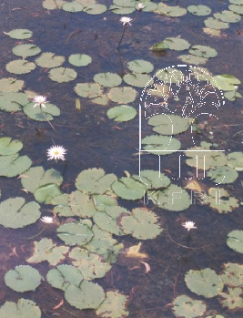
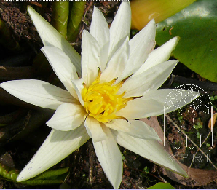
Nymphaea nouchali
Courtesy KFRI
Courtesy KFRI
Ambel , Neerambel, Periambel, Poothali ,Vellampel
Courtesy KFRI

Slide 12
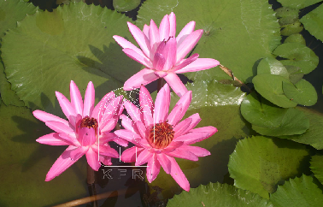
Courtesy KFRI
Nymphaea omarana
Courtesy KFRI

Slide 13
Courtesy KFRI
Nymphaea pubescens
Ambal, Neerambal, Periambal
Courtesy KFRI

Slide 14
Courtesy KFRI
Nymphaea rubra
Courtesy KFRI

Slide 15
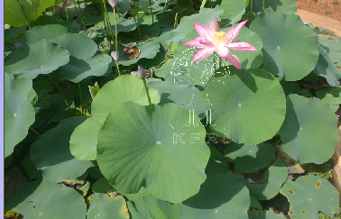
Courtesy KFRI
Nelumbo nucifera
Courtesy KFRI
Thamara, Chenthamara, Venthamara

Slide 16
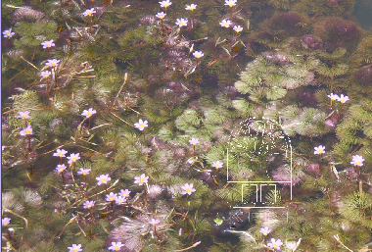
Courtesy KFRI
Courtesy KFRI
Cabomba caroliniana
Mullenpayal
Courtesy KFRI

Slide 17
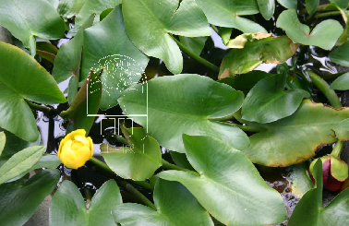
Courtesy KFRI
Nuphar japonica
Courtesy KFRI

Slide 18
Sub Families
On the basis of floral construction - 3 subfamilies
Cabomboideae - cyclic trimerous flowers with apocarpous ovary
Nelumboideae - Apocarpous ovary
Nymphaeoideae - Syncarpous ovary

Slide 19
Distribution
This family includes 8 genera and over 90 species.
Cosmopolitan in distributed, except in cold regions

Slide 20
Habit
Aquatic – Freshwater
Perennial herbs with large rhizomes
Sometimes annuals - Euryale
Submerged
Free floating in shallow lakes or ponds etc.

Slide 21
Leaves
Simple
Exstipulate
Alternate
Long petioles
Submerged floating or immersed.

Slide 22
Leaves
Large in Victoria (2 meters)
Smooth waxy but lower portion prickly (Euryale)
Nymphaea - orbicular, sagittate or oval.
Cabomba - heterophilly

Slide 23
Inflorescence
Solitary and Axillary
Courtesy KFRI
Courtesy KFRI

Slide 24
Flowers
Courtesy KFRI
Bisexual
Actinomorphic
Large and showy
Long peduncle
Usually hypogynous
Epigynous in Victoria
Perigynous in Nymphaea
Courtesy KFRI
Courtesy KFRI

Slide 25
Calyx
Courtesy KFRI
Sepals 3 to many
Polysepalous
Nuphur sepals are yellow and larger than petals
sepals 3 in Brasenia
4 in Nelumbo and Nymphaea
5 in Barclaya
Courtesy KFRI
Courtesy KFRI

Slide 26
Corolla
Courtesy KFRI
Petals 3 to many – polypetalous
Petals frequently grading into stamens
Inner petals form petaloid staminodes
While or variously coloured and showy
A nectary is present in abaxial side in Nuphur
Aestivation imbicate
Courtesy KFRI
Courtesy KFRI

Slide 27
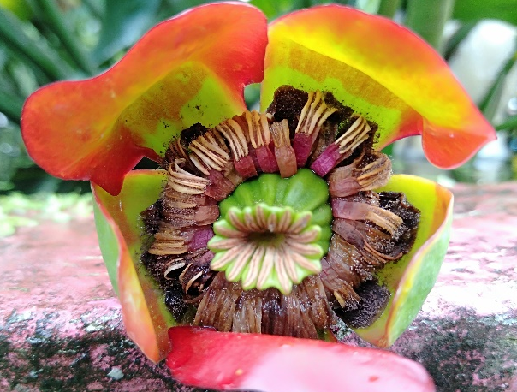
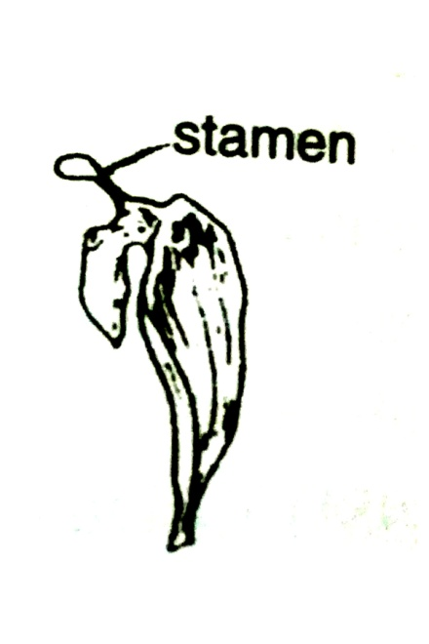
Androecium
3 to many
Filaments extend as sterile appendage beyond the anther sacs
Anther dithecous, basifixed or adnate
Introse - dehiscence longitudinal
In Victoria the inner stamens are sterile
In Nelumbo and Nymphaea the stamens are spirally arranged

Slide 28
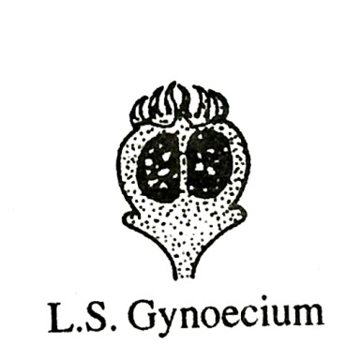
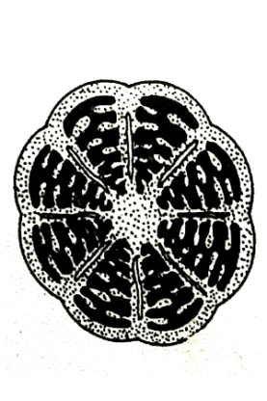
Gynoecium
2 to 3 carpels - Cabomba
Numerous - Nelumbo, Nymphaea
Each carpel with 1 locule, numerous ovules
Marginal or parietal placentation
Ovary superior but inferior in Victoria and Euryale
Stigmas mostly 1 and discoid or as many as 35 and radiate
Numerous carpels of Nymphaea and Nelumbo - Swollen receptacle

Slide 29
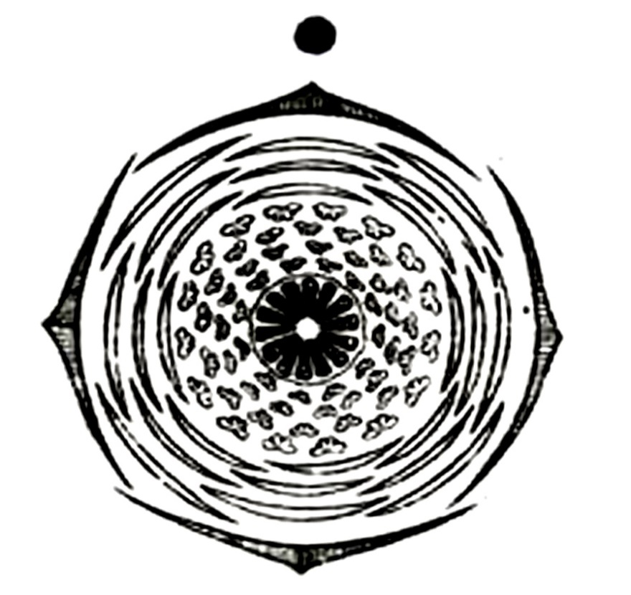
L S of flower
Floral Diagram

Slide 30
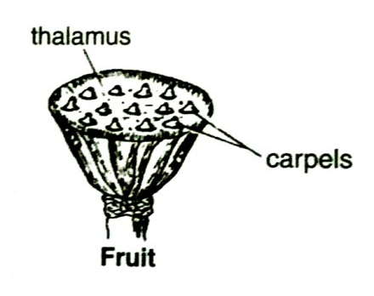
Fruit
Spongy berry in Nymphaea
Follicle as in Cabomba
Seeds 1 to many per locule
Embryo straight - starchy endosperm

Slide 31
Economic importance
Ornamentals
Nymphaea caerulea , N. nouchali N. pubescens, Nelumbo nucifera and
Victoria regia
Edible products
Rhizome of Nymphaeae noucali
Rhizome young leaves, fruiting torus flowers and petioles
of Nelumbo nucifera - vegetables.
Seeds of Victoria regia are roasted and eaten
Medicinal properties
Flowers of Nelumbo nucifera - cardiac tonic and also used in curing liver and skin diseases.
Rhizomes of Nymphaea nouchali are used to cure dysentery and diarrhea.
Cosmetics
Flowers of Nelumbo nucifera yield a valuable perfume.

Slide 32
Primitive Characters
Xylem - Tracheids - long - spiral or annular thickening
Actinomorphic symmetry - large size - spiral arrangement of flowers
Transition of floral parts
Bisexual
Hypoynous - Prominent thalamus
Numerous stamens - spiral arrangement - sterile terminal tip
Uniapperturate pollen grains
Polycarpellary – apocarpous Numerous ovules per carpels

Slide 33
Thank you

