Slide 1
ELECTROPHORESIS By, Dr. Johnson Baby Associate Professor in Zoology

Slide 3
Electrophoresis
The term electrophoresis means any experimental technique that is based on movement of charged particles (ions, molecules, macromolecules) in electric field in liquid medium.
Any electrically charged particle dissolved in aqueous solution, when placed to a constant electric field, will start to migrate towards the electrode bearing the opposite charge
The speed of the particle movement will be directly proportional to the applied voltage and particle charge, but inversely proportional to the particle size.
The electrophoretic analysis can in principle be applied to any particles that are charged under given experimental condition, such as small cations or anions, organic acids, amino acids, peptides, saccharides, lipids, proteins, nucleotides, nucleic acids, even the whole subcellular particles or the whole cells.

Slide 4
Electrophoresis is usually done with gels formed in tubes, slabs, or on a flat bed.
In many electrophoresis units, the gel is mounted between two buffer chambers containing separate electrodes, so that the only electrical connection between the two chambers is through the gel.
(applied voltage) (net charge on the molecule)
Mobility of a molecule =
(friction of the molecule)

Slide 6
E = V
d
Anode
anions
q charge
100 V
150 V
200 V
Sample
d
Current from Power Pack
Gel (Solid Support)
Velocity = Eq
F (friction)
Cations
Cathode

Slide 7
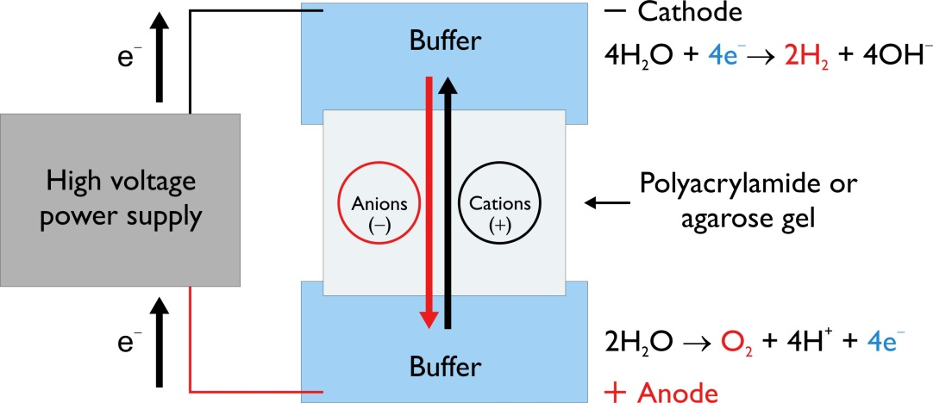
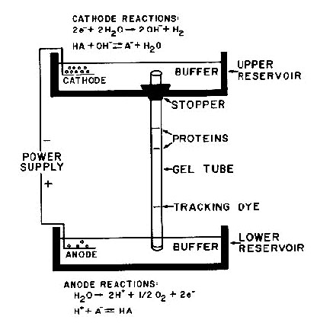

Slide 8
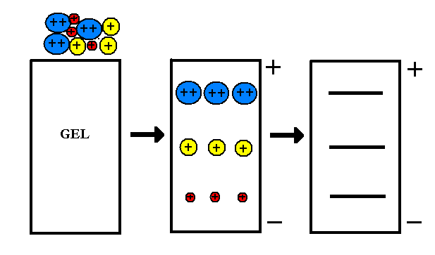

Slide 9
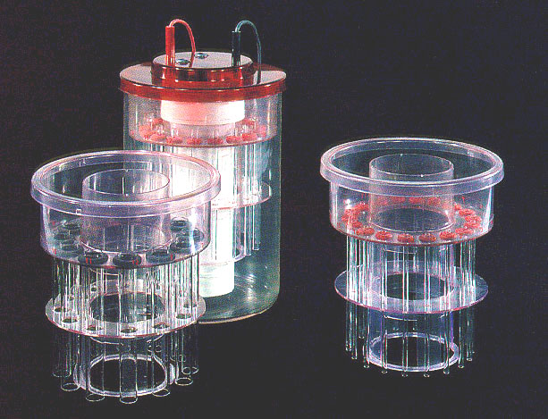
Tube Gel Units

Slide 10
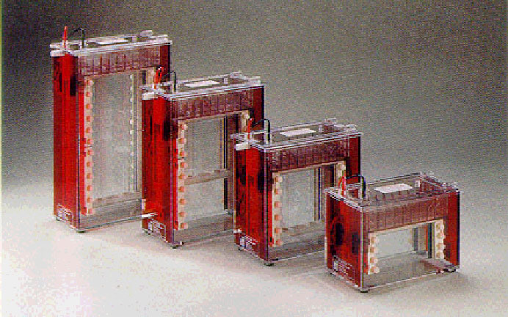
Slab Gel Units

Slide 11
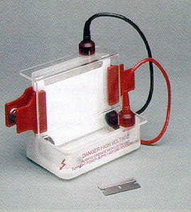
Slab Gel Unit

Slide 12
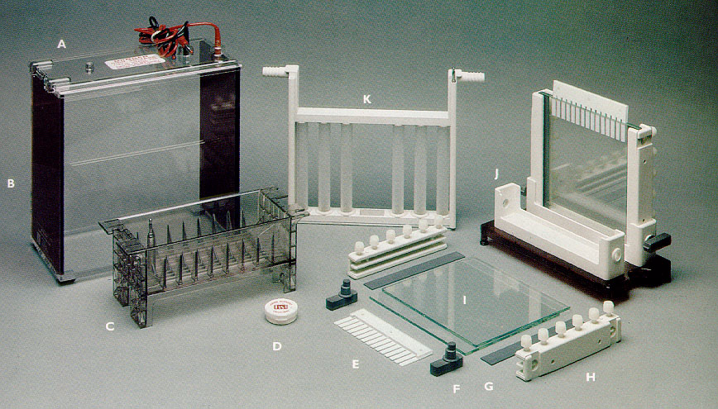
Slab Gel Unit

Slide 13
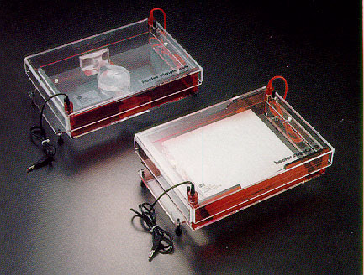
Flat Bed Unit

Slide 14
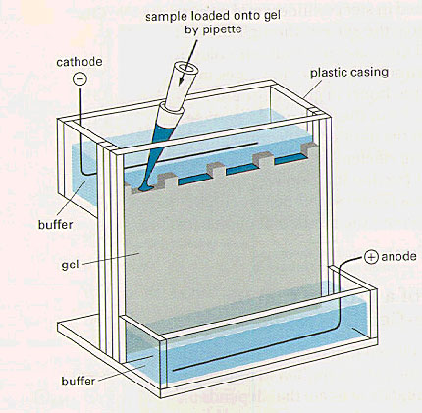
In most electrophoresis units, the gel is mounted between two buffer chambers containing separate electrodes so that the only electrical connection between the two chambers is through the gel.

Slide 16
Gel Electrophoreis
When electrophoresis is performed in acrylamide or agarose gels, the gel serves as a size-selective sieve during separation. As proteins move through a gel in response to an electric field, the gel’s pore structure allows smaller proteins to travel more rapidly than larger proteins
The gel is mounted between two buffer chambers, and the only electrical path between the two buffers is through the gel. Usually, the gel has a vertical orientation, and the gel is cast with a comb that generates wells in which the samples are applied
Applying an electrical field across the buffer chambers forces the migration of protein into and through the gel

Slide 17
What is the use of Gel
It inhibits convection and diffusion, which would otherwise impede separation of molecules
It allows a permanent record of results through staining after run
It can provide additional separation through molecular sieving

Slide 19
Agarose and Polyacrylamide
Although agarose and polyacrylamide differ greatly in their physical and chemical structures, they both make porous gels.
A porous gel acts as a sieve by retarding or, in some cases, by completely obstructing the movement of macromolecules while allowing smaller molecules to migrate freely.
By preparing a gel with a restrictive pore size, the operator can take advantage of molecular size differences among proteins

Slide 20
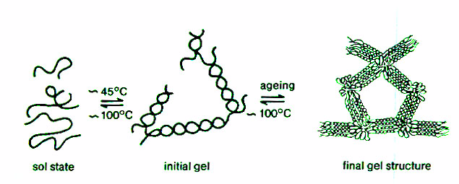
Gel Structure of Agarose

Slide 21
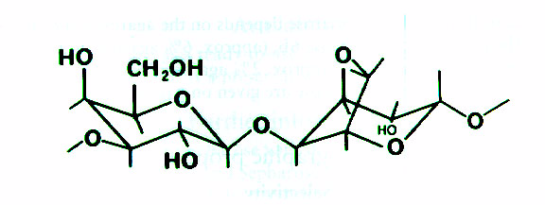
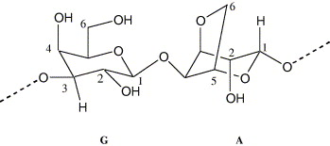
Structure of the Repeating Unit of Agarose, 3,6-anhydro-L-galactose
Basic disaccharide repeating units of agarose,
G: 1,3-β-d-galactose
and
A: 1,4-α-l-3,6-anhydrogalactose

Slide 22
Agarose Gels
Agarose is a highly purified uncharged polysaccharide derived from agar
Agarose dissolves when added to boiling liquid. It remains in a liquid state until the temperature is lowered to about 40° C at which point it gels
The pore size may be predetermined by adjusting the concentration of agarose in the gel
Agarose gels are fragile, however. They are actually hydrocolloids, and they are held together by the formation of weak hydrogen and hydrophobic bonds

Slide 23
Polyacrylamide Gels
Polyacrylamide gels are tougher than agarose gels
Acrylamide monomers polymerize into long chains that are covalently linked by a crosslinker
Polyacrylamide is chemically complex, as is the production and use of the gel

Slide 24
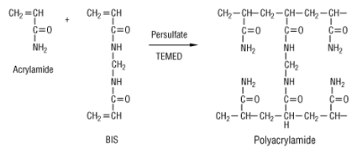

Slide 25
Agarose and Polyacrylamide
Because the pores of an agarose gel are large, agarose is used to separate macromolecules such as nucleic acids, large proteins and protein complexes
Polyacrylamide, which makes a small pore gel, is used to separate most proteins and small oligonucleotides.
Both are relatively electrically neutral

Slide 27
DRAWBACKS OF PAGE
Data from native PAGE are difficult to interpret. Since the native charge-to-mass ratio of proteins is preserved, protein mobility is determined by a complex combination of factors. Since protein-protein interactions are retained during separation, some proteins may also separate as multisubunit complexes and move in unpredictable ways. Moreover, because native charge is preserved, proteins can migrate towards either electrode, depending on their charge. The result is that native PAGE yields unpredictable separation patterns that are not suitable for molecular weight determination.

Slide 28
SDS-PAGE
To overcome the limitations of native PAGE systems, Laemmli (1970) incorporated the detergent sodium dodecyl sulfate (SDS) into a discontinuous denaturing buffer system, creating what has become the most popular form of protein electrophoresis, SDS-PAGE.
When proteins are separated in the presence of SDS and denaturing agents, they become fully denatured and dissociate from each other. In addition, SDS binds noncovalently to proteins in a manner that imparts an overall negative charge on the proteins. Since SDS is negatively charged, it masks the intrinsic charge of the protein it binds

Slide 29
A long, rod-like shape on the proteins instead of a complex tertiary conformation
A similar charge-to-mass ratio for all proteins in a mixture, since SDS binds at a consistent rate of 1.4 g of SDS per 1 g protein (a stoichiometry of about one SDS molecule per two amino acids)
As a result, the rate at which SDS-bound protein migrates in a gel depends primarily on its size, enabling molecular weight estimation. The original Laemmli system incorporated SDS in
the gels and buffers, but SDS is not required in the gel. SDS in the sample buffer is sufficient to saturate proteins, and the SDS in the cathode buffer maintains the SDS saturation during electrophoresis. A range of gel and buffer combinations can be used for native and SDS-PAGE, each with its own advantages

Slide 30
Effect of SDS on the conformation and charge of protein

Slide 32
HIGH VOLTAGE ELECTROPHORESIS
sample vial,
source and
destination vials,
a capillary,
electrodes,
a high voltage power supply,
a detector, and a data output and handling device.
The source vial, destination vial and capillary are filled with an electrolyte such as an aqueous buffer solution. To introduce the sample, the capillary inlet is placed into a vial containing the sample.
Sample is introduced into the capillary via capillary action, pressure, siphoning, or electrokinetically, and the capillary is then returned to the source vial.

Slide 33
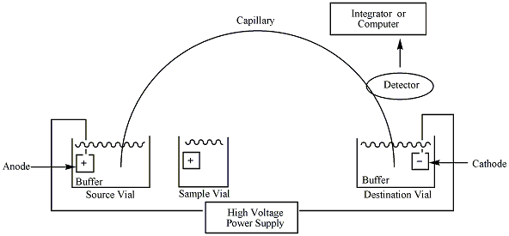
INSTRUMENTATION

Slide 34
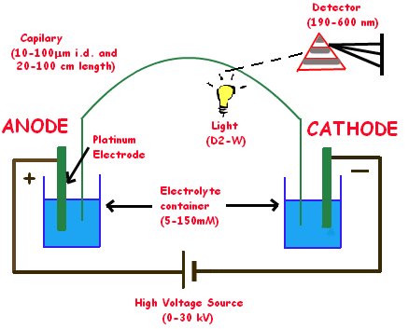

Slide 35
The migration of the analytes is initiated by an electric field that is applied between the source and destination vials and is supplied to the electrodes by the high-voltage power supply.
In the most common mode of CE, all ions, positive or negative, are pulled through the capillary in the same direction by electroosmotic flow.
The analytes separate as they migrate due to their electrophoretic mobility, and are detected near the outlet end of the capillary.
The output of the detector is sent to a data output and handling device such as an integrator or computer.
The data is then displayed as an electropherogram, which reports detector response as a function of time. Separated chemical compounds appear as peaks with different retention times in an electropherogram

Slide 37
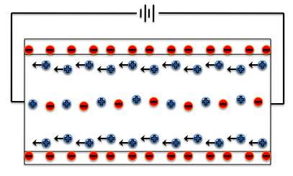
ELECTROSMOTIC FLOW
Motion of liquid induced by an applied potential across a capillary tube. Electroosmotic velocities are independent of conduit size, as long as the electrical double layer is much smaller than the characteristic length scale of the channel

Slide 44
The Net Charge is Determined by the pH of the Medium
Proteins are amphoteric compounds, that is, they contain both acidic and basic residues
Each protein has its own characteristic charge properties depending on the number and kinds of amino acids carrying amino or carboxyl groups
Nucleic acids, unlike proteins, are not amphoteric. They remain negative at any pH used for electrophoresis

Slide 47
ISOELECTRIC FOCUSING
A protein is depicted in a pH gradient in an electric field. A pH gradient formed by ampholyte molecules under the influence of an electric field is indicated. The gradient increases from acidic (pH 3) at the anode to basic (pH 10) at the cathode. The hypothetical protein in the drawing bears a net charge of +2, 0, or –2, at the three positions in the pH gradient shown. The electric field drives the protein toward the cathode when it is positively charged and toward the anode when it is negatively charged, as shown by the arrows. At the pI, the net charge on the protein is zero, so it does not move in the field. The protein loses protons as it moves toward the cathode and becomes progressively less positively charged. Conversely, the protein gains protons as it moves toward the anode and becomes less negatively charged. When the protein becomes uncharged (pI), it ceases to move in the field and becomes focused.

