Slide 1
Molecular Symmetry
&
Group Theory
Dr. Sujesh Baby
Assistant Professor in Chemistry
Christian College Chengannur

Slide 2
Symmetry Element and Symmetry Operation
A symmetry element is a geometrical entity such as a point through which an inversion is carried out or a plane through a reflection is carried out or a line about which a rotation is carried out in order to generate an equivalent orientation.
A symmetry operation is a movement such as an inversion through a point, a reflection through a plane or a rotation about a line in order to generate an equivalent orientation.
An equivalent orientation is an orientation indistinguishable or similar to the initial orientation.
An orientation same as the initial orientation is called an identical orientation or original orientation.

Slide 3
Symmetry Elements | Symmetry operations | Schoenflies notation
Centre of Symmetry | Inversion | i
Plane of symmetry | Reflection | σ
Proper axis of symmetry | Rotation through 360˚/n | C_{n}
Improper axis of symmetry | Rotation followed by reflection in a plane Ʇ to the rotational axis | S_{n}
Identity | Operation to do nothing | E

Slide 4
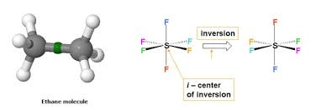
Centre of Symmetry
A point inside the object, from which lines drawn to opposite directions will meet similar points at the same distance.
Or
Reflection with respect to a point give an equivalent configuration ; then it possess the centre of symmetry
Molecules like N₂F₂, C₂H₄, C₂H₆(Stag), C₆H₆, SF₆,XeF₄ have center of symmetry.
Molecules like CH₄, H₂O, NH₃, BF₃have no center of symmetry.
The inversion operation i transforms a point (x,y,z) into (-x,-y,-z).

Slide 5
Plane of Symmetry
A plane which divides the object into two equal halves such that one half is the exact mirror image of the other half.
Or
Reflection with respect to a plane gives an equivalent configuration, then it possesses a plane of symmetry.
Molecules having plane of symmetry are water (2), Ammonia (3), BF₃ (4) XeF₄ (5), ethane(stag) (3), ethane(ecl) (4), benzene (7), ethene (3), CH₄ ( 6), SF₆ (9) and HCl (infinity)
Molecules having no plane of symmetry are H₂O₂, CHClBrI, CHClBr-CClBrI

Slide 6
Classification of Planes of symmetry
The principal axis is taken to be vertical and coinciding with the z-axis.
Planes which are lying along the direction of principal axis is known as vertical planes and denoted as σ_{v} (vertical plane).
If the plane bisecting the dihedral angle between σ_{v} planes :- dihedral plane,σ_{d}.(dihedral plane)
Plane of symmetry perpendicular to the principal axis is horizontal plane denoted as σ_{h}.(horizontal plane)

Slide 7
Proper Axis of Symmetry
An axis passing through the object, about which when the object is rotated through 360˚/n, an equivalent orientation is generated.
Molecules having proper axis are H₂O(C₂), NH₃(C₃), BF₃(C₃ and 3C₂), XeF₄(C₄ and 4C₂), H₂C=CH₂(3C₂), H₂C=C=CH₂(3C₂), CH₃-CH₃(C₃ and 3C₂), Benzene ( C₆ and 6C₂), CH₄ (4C₃ and 3C₂) and SF₆ (3C₄,4C₃and 6C₂).

Slide 8
Principal and Subsidiary Axes
In cases where a principal axis is identified, other axes, if any, are known as subsidiary axes.
The subsidiary axes will be C₂ axes.
They will be perpendicular to the principal axis
If the principal axis is C_{n}, there will be n C₂ axes as subsidiary axes.
It follows that a C_{n} will combine with either no C₂ axes or nC₂ axes only.

Slide 9
Which is the Principal Axis ?????
If only one C_{n} is present, it will be the principal axis. Eg: C₂ in water, C₃ in ammonia
The Higher order axis is the principal axis.
Axis passing through maximum no. of atoms. (Eg. Naphthalene, ethylene and allene ,three C₂ axis are present). The Principal axis is the one which passes through maximum no. of atoms.
The axis perpendicular to the plane of the object (in planar species)is taken as principal axis.
Eg. trans[Pt(NH₃)₂(Cl)₂], three C₂, two are passing through three
atoms.

Slide 10
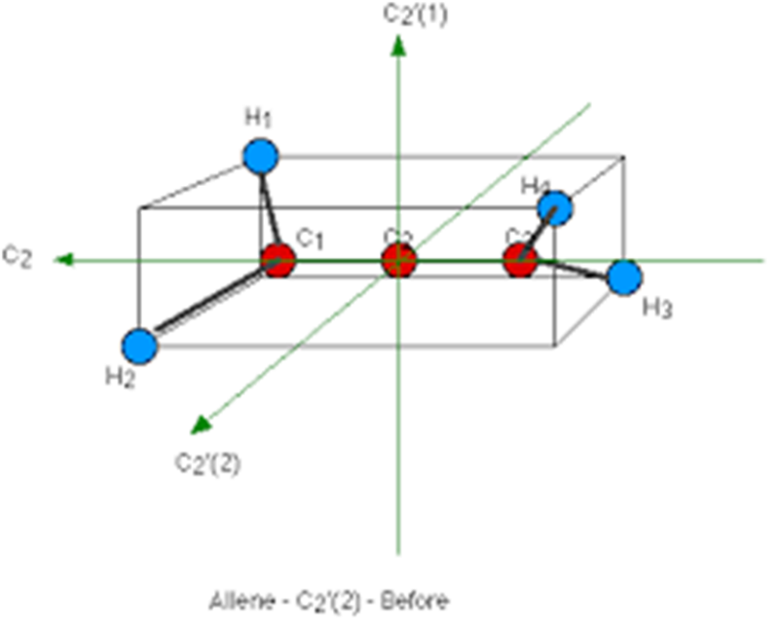

Slide 11
Improper Axis of Symmetry
An axis passing through the object about which when the object is rotated through 360˚/n followed by a reflection in a plane perpendicular to the axis generates an equivalent orientation; it is S_{n}.
N₂F₂ has an S₂, CH₄ has 3S₄, SF₆ has 3S₄ and 4S₆, BF₃ has an S₃, XeF₄ has an S₄.
It follows that the presence of a C_{n} and a σ_{h} necessitate the presence of an S_{n}; the converse is not true.
BF₃ molecule has an S₃ axis
In general: Sn with n even ,,
S_{n}^{n}= C_{n}^{n}.σ^{n} = E .
Sn with n odd , S_{n}^{n}= C_{n}^{n}.σ^{n} = σ
; S_{n} ^{n} =σh, S_{n} ^{2n} =E

Slide 12
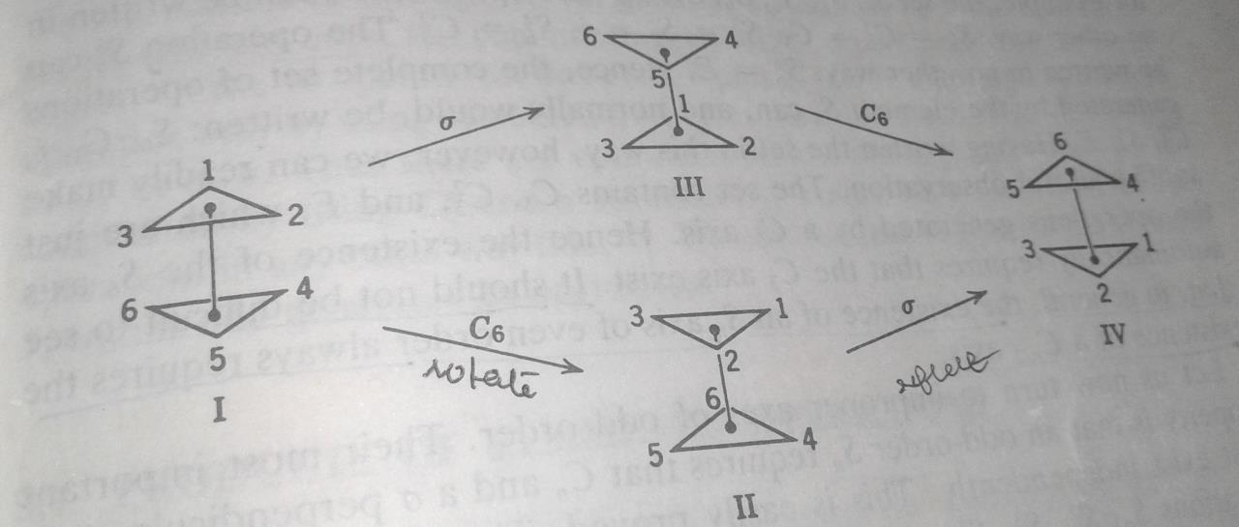
Staggered ethane molecule

Slide 13
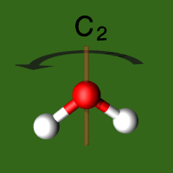
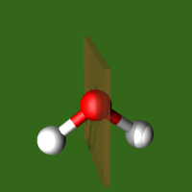
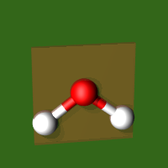
Water Molecule
E
C₂
σ_{v}(xz)
σ_{v}(yz)

Slide 14
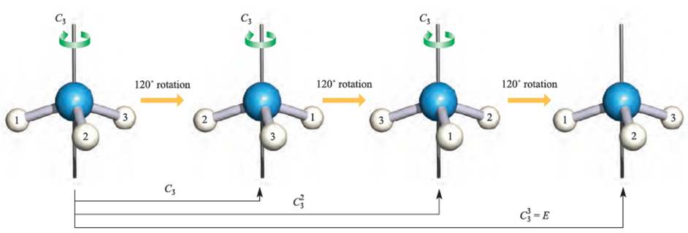
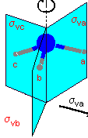
Ammonia
E

Slide 15
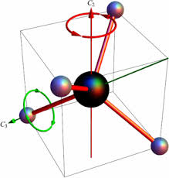
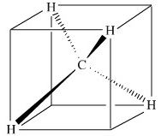
Methane
(T_{d})
E, 4 C₃, 3C₂, 6σ_{d}, 3S₄

Slide 16
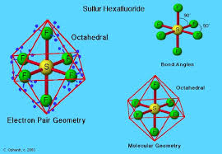
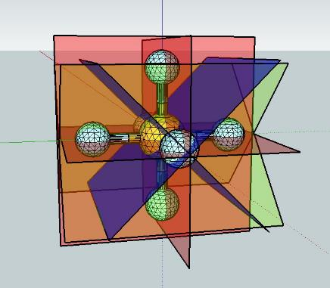
(O_{h})
SF₆
3C₄,4C₃,6C₂ & 3σ_{h}, 4S₆, 6σ_{d} & i- O_{h}

Slide 17
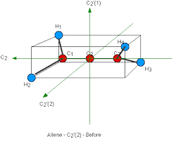
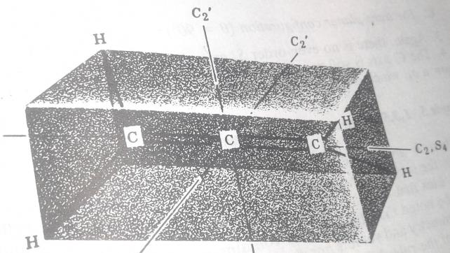
Allene
E, 3C₂, 2 σ_{d}

Slide 18
Operations Generated by Symmetry Elements
A symmetry element is associated with or generates certain operations.
Thus a σ generates a σ and σ x σ=E, the identity operation.
An i also generates i and i x i=E.
A C_{n} generates C_{n}, C_{n}², C_{n}³……. up to C_{n}^{n}=E
An S_{n} generates S_{n}, S_{n}²=C_{n}, S_{n}³=σ….. up to S_{n}^{n} =E if n is even or S_{n}^{2n} = E if n is odd.

Slide 19
Point Group
It follows that the symmetry elements can combine only in a limited number of ways.
A possible combination of symmetry elements is called a point group.

Slide 20
Point groups | Essential Symmetry Elements
C_{n} | Only a C_{n}
C_{nh} | A C_{n} and a σ_{h}
C_{nv} | A C_{n} and nσ_{v}
D_{n} | A C_{n} and nC₂’s
D_{nh} | A C_{n}, nC₂’s & a σ_{h}
D_{nd} | A C_{n}, nC₂’s & nσ_{d}’s
S_{n} | Only an S_{n}
T_{d} | 4C₃, 3C₂ & 6σ_{d}
O_{h} | 3C₄,4C₃, 6C₂ & 3σ_{h}

Slide 21
Assigning Point Groups
To assign the point group, we have first look for a principal axis, then for C₂ axes, then for σ_{h} and then for σ_{v}.
If no axis is there, the point groups can be C_{i}, C_{s}, S_{n} or C₁.
If no subsidiary axes are there, the point groups can be C_{nh}, C_{nv} or C_{n}.
If subsidiary axes are also there, the point groups can be D_{nh}, D_{nd} or D_{n}.
If many higher order axes are there and the principal axis cannot be assigned, the point group can be T_{d}, O_{h} or (rarely) I_{h}.
The Yes-No response can be used to assign the point group.

Slide 22
Yes-No Response for Assigning Point Group
Is there an axis of sym?
No
yes
Is there a sigma
Is it unique
no
yes
No
yes
Are there nC₂’s
Is there an i
C_{s}
Look for T_{d} or O_{h}
no
yes
yes
No
Is there a σ_{h}
Is there a σ_{h}
Is there an Sn
no
yes
yes
no
yes
No
C_{i}
Are there nσ_{d}
Are there nσ_{v}
C_{nh}
D_{nh}
no
yes
C₁
S_{n}
no
yes
C_{n}
C_{nv}
D_{n}
D_{nd}

Slide 23
Examples for point group
H₂O has a C₂ and 2σ_{v}- point group C_{2V}
NH₃-C₃ & 3σ_{v}- C_{3V}
BF₃-C₃, 3C₂ & σ_{h}- D_{3h}
XeF₄-C₄, 4C₂ & σ_{h}—D_{4h}
C₆H₆₋C₆, 6C₂ & σ_{h}- D_{6h}
C₂H₆ (ecl)-C₃, 3C₂ & σ_{h}- D_{3h}
C₂H₆(stag)-C₃, 3C₂ &3σ_{d}-D_{3d}
C₂H₄-C₂,2C₂ & σ_{h-}D_{2h}
CH₄-4C₃, 3C₂ &6σ_{d-}T_{d}
SF₆-3C₄,4C₃,6C₂ & 3σ_{h}-, 4S₆, 6σ_{d} & i- O_{h}
Allene-C₂,2C₂ & 2σ_{d}-D_{2d}

Slide 24
Order of a group
The total number of distinct elements of a group is the order of the group.
In the C_{2v} point group, the sym. Elements are E, C₂, σ_{v} and σ_{v}’.
The C₂ generates the operations C₂ and E
Each of the σ’s generates σ and E.
Avoiding redundancy, the operations generated by all the symmetry elements of the C_{2v} point group are E,C₂, σ_{v} and σ_{v}’.
Thus there are four non redundant symmetry operations generated by all the symmetry elements of this group. The order of the C_{2v} point group is 4.
These symmetry operations are the elements of the group.

Slide 25
Examples of order of a few groups
In the C_{3V} group, the elements are E,C₃,C₃²,σ_{V}’,σ_{V}” and σ_{V}”’. The order is 6
In the D_{3h} group, the elements are E,C₃,C₃²,C₂’,C₂”,C₂”’,σ_{h} S₃,S₃⁵,σ_{V}’,σ_{V}” and σ_{V}”’. The order is 12.
In the T_{d} group, there are 4C₃, 3C₂, 3S₄ and 6σ_{d} as the sym. Elements. Each of the C₃ generates C₃ and C₃²; each S₄ generates S₄ and S₄³; thus the elements of the group are E, 4C₃, 4C₃²,3C₂,3S₄,3S₄³ and 6σ_{d} making a total of 24 elements; the order of the group is 24.
In general order of C_{n} group is n, of D_{n},C_{nh} and C_{nv} groups is 2n, of D_{nh} and D_{nd} groups is 4n,of O_{h} is 48 and of I_{h} is 120.

Slide 26
Properties of a Group
A set of elements will form a group if they obey the following group theoretical rules ;
Combination law: The products of two elements of a group is an element of the same group.
Commutative law :In general two elements do not commute. But every group contains one element which commutes with every other elements of the group and leaves them unchanged. This is the identity element (E).
The associative law of multiplication is valid for the elements of a group. i.e., (AB)C = A(BC) where A,B,C are elements of a group.
Every element has an inverse which is also an element of the same group. An inverse is an operation which undoes the change brought about by the operation. If A is an operation, its inverse A⁻¹ is defined as A⁻¹A = AA⁻¹ =E.

Slide 27
Abelian group :-
In certain groups, every two elements may commute. This is called an abelian group.
Eg: In C_{2V} point group, all the elements are commute to each other.
Cyclic group :-
If the elements of a group can be derived from one basic element, it is called a cyclic group.
Eg: In C₃ point group, the elements are E, C₃¹ &C₃² . C₃ is the basic element.

Slide 28
Group Multiplication Table
It is a table containing the binary products of the elements of a group.
The table can be constructed by finding the binary product
:- Using the coordinate transformation method.

Slide 29
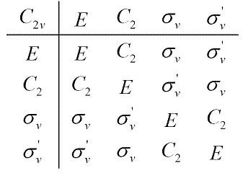
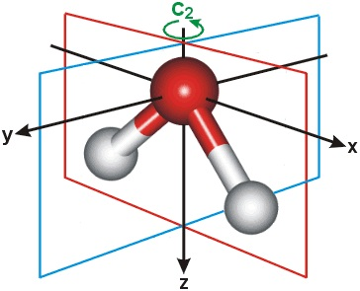
Group multiplication table for C_{2v} point group
Eg: H₂O

Slide 30
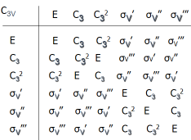
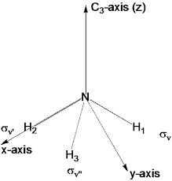
Group multiplication table for C_{3v} point group
Eg. : NH₃

Slide 31
Similarity transformation &classification of symmetry operation
The elements of a group can be classified in to different classes.
A class may contain one element or more.
The classification of elements is done by a procedure called Similarity transformations.
If A and X are two elements of a group and X⁻¹ is the inverse of X, then A is similarity transformed as X⁻¹AX=B. A is said to be similarity transformed to B, or A and B are conjugate elements or A and B form one class.

Slide 32
Classification of Elements of C_{2V} Point group
We shall similarity transform the elements of the C_{2V} point group using all the elements.
For similarity transforming E,
EEE=E; C₂EC₂=E; σ_{v}Eσ_{v}=E; σ_{v}’Eσ_{v}’=E. E transforms only as E; it forms a class by itself.
EC₂E=C₂; C₂C₂C₂=C₂; σ_{v}C₂σ_{v}=C₂; σ_{v}’C₂σ_{v}’=C₂. C₂ forms a class by it self.
Eσ_{v}E=σ_{v}; C₂σ_{v}C₂=σ_{v}; σ_{v}σ_{v}σ_{v}=σ_{v}; σ_{v}’σ_{v}σ_{v}’=σ_{v}. σ_{v} also forms one class. Naturally, σ_{v}’ will form a class.
Each of the elements of the C_{2v} forms a class; there are four classes in this group.

Slide 33
Classification of elements of C_{3V} Point Group
E always forms a class by itself.
To similarity transform C₃:
EC₃¹E=C₃¹; C₃²C₃¹C₃¹=C₃¹; C₃¹C₃¹C₃²=C₃¹;
σ_{v}’ C₃¹σ_{v}’=σ_{v}’σ_{v}”’=C₃²; σ_{v}” C₃¹σ_{v}”=σ_{v}”σ_{v}’=C₃² ; σ_{v}”’ C₃¹σ_{v}”’=σ_{v}”’σ_{v}’’=C₃²
C₃¹ transforms as C₃¹ and C₃²; hence C₃¹ and C₃² form one class.
To similarity transform σ_{v}’
Eσ_{v}’E=σ_{v}’; C₃²σ_{v}’C₃=C₃²σ_{v}”=σ_{v}”’; C₃σ_{v}’C₃²=C₃σ_{v}”’=σ_{v}”; σ_{v}’σ_{v}’σ_{v}’=σ_{v}’;
σ_{v}”σ_{v}’σ_{v}”=σ_{v}”C₃=σ_{v}”’; σ_{v}”’σ_{v}’σ_{V}’”=σ_{V}”’C₃²=σ_{v}”
All the three σ’s form one class.
In C_{3V} only three classes

Slide 34
Matrix representation
A matrix is an array of numbers as
This is a 3X4 matrix. It contains 3 rows and 4 columns.
An m x n matrix contains m rows and n columns.

Slide 35
A square matrix will have equal number of rows and columns.
In a square matrix the sum of the diagonal elements is called the character or trace of a matrix denoted by the Greek letter χ
For example, the character of the matrix,
is 10.

Slide 36
Matrix multiplication
Two matrices can be multiplied only if the number of columns in the first matrix is equal to the number of rows in the second matrix.
Eg:

Slide 37
The elements in the resultant matrix are obtained as
C11 =a11b11 + a12b21+ a13b31
C12 = a11b12 + a12b22 + a13b32
C21 = a21b11+ a22b21 + a23b31
………………………………………
We cannot find the product if the matrices are interchanged.
It follows that matrix multiplication is not commutative, in general.
A square matrix which has non-zero elements only along the diagonal is called a diagonal matrix.
If all the non zero elements of a diagonal matrix are unity, it is called a unit matrix.
The number of rows or columns in a square matrix is called its dimension.
The dimension and the character of a unit matrix will be the same.

Slide 38
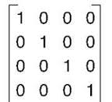
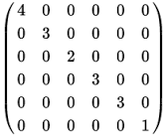
Diagonal matrix
Unit matrix

Slide 39
Block-factored matrices
A matrix of the following type, which contains non zero elements only in blocks along the diagonal of the matrix is called a blocked out matrix.

Slide 40
A set of matrices all of which are blocked out in the same way is called block-factored matrices.
Each of the blocks in a block factored matrix will behave as an individual matrix.
For example, the above five-dimensional matrix behaves as a one dimensional matrix and two 2-dimenional matrices.
Hence to find the product of two block factored matrices, it is sufficient to multiply only between the respective blocks. The product matrix will also be similarly blocked out.

Slide 41
Simultaneous equations as matrix products
A single column matrix represents a vector
One of the important aspect of matrix multiplication is that simultaneous equations can be expressed as matrix products.
For example, the simultaneous equations
Can be expressed as the following matrix product.

Slide 42
Matrix or Group Representation
Matrices can be used to represent symmetry operations, i.e.,elements of a group.
Let us take that ,in general, a symmetry operation transforms a point (x,y,z) into (x’, y’, z’)
We know that inversion transforms a point (x,y,z) into (-x,-y,-z).

Slide 43
Matrix representation of C_{2v} point group
The C2v point group has E,C2,σv and σv’as the elements. The respective matrices will be as follows.
All these can be blocked out similarly. Hence they form a set of block factored matrices.
σ_{xz}
σ_{yz}

Slide 44

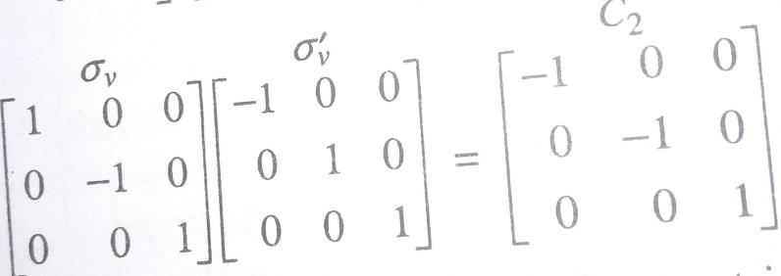
Do the remaining exercises?????????????????????

Slide 45
It can also be seen that any two of these matrices combine just as the respective elements combine. Such a set of matrices is known as a group or matrix representation.
Here we get a set of three dimensional matrices because we have started with a coordinate point. The dimension of the matrix representation will depend upon the number of points we have selected.
If we use three coordinate points of water molecule, a nine dimensional matrix representation can be set.
The three points in the water molecule are defined by the coordinates (x1,y1,z1), (x2,y2,z2) and (x3,y3,z3)

Slide 46
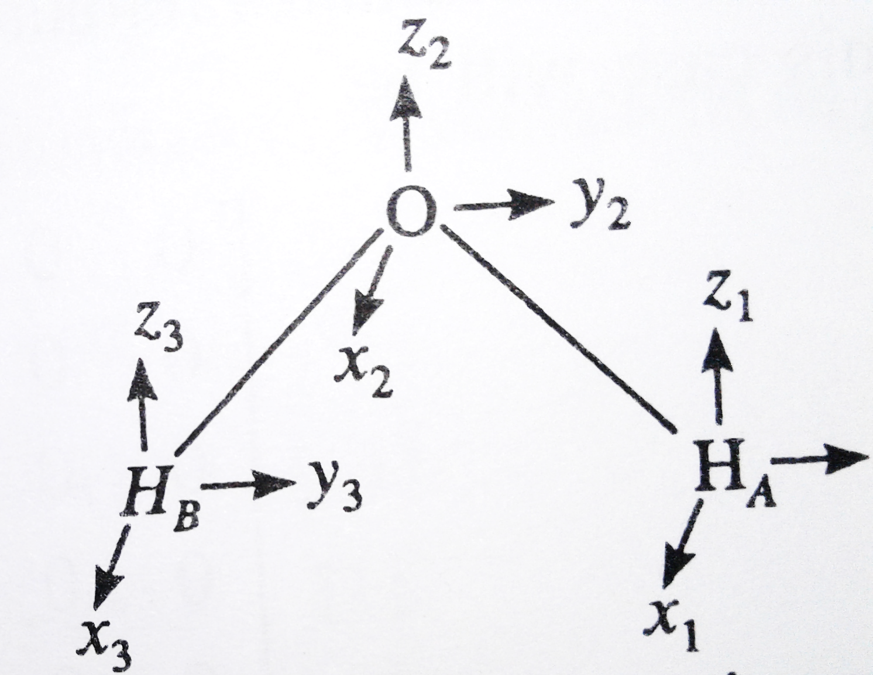
y₁

Slide 47
Let the coordinates transform in to(x1’,y1’,z1’), (x2’,y2’,z2’) and (x3’,y3’,z3’) during a symmetry operation.
The matrix product for the identity operation (E) is,

Slide 48
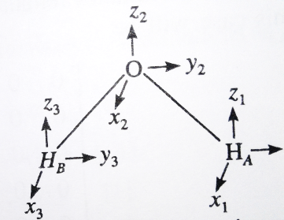
When the molecule subject to C₂ operation, Hydrogen atoms A and B get exchanged and hence x1,y1,z1 changed to x3,y3,z3 and viceversa. The direction of x and y coordinates also changes
Ie, x1 to –x3, y1 to –y3 and z1 to z3.
x2 to –x2, y2 to –y2 and z2 to z2
and
x3 to –x1, y3 to –y1 and z3 to z1
y₁

Slide 49
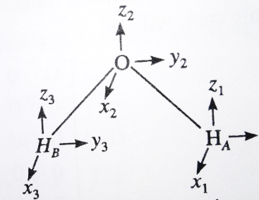
If the operation σ_{v} is performed H_{A} and H_{B} get exchanged. The X and Z coordinates remains unchanged while Y coordinate changed to -Y
y₁
Z1 to Z3
X1 to X3
Y1 to –Y3
Z3 to Z1
X3 to X1
Y3 to –Y1
X2 to X2
Z2 to Z2
Y2 to –Y2

Slide 50
If the operation σ_{v}’ is performed H_{A} and H_{B} remains as such. The Y and Z coordinates remains unchanged while X coordinate changed to -X
y₁

Slide 51
The dimension and complexity of the matrices in a group representation
will depend upon the system we take as the basis.
A blocked-out matrix can be taken as independent matrices of smaller dimensions. The Procedure of conversion of a matrix of larger dimension in to smaller dimensional matrices is called reduction.
If the matrices of a group representation can be reduced to smaller dimensional matrices, such a representation is called reducible representations.

Slide 52
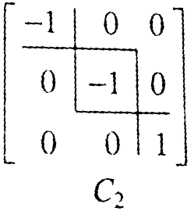
The three dimensional matrix representation given above contains block factored matrices as:

Slide 53
This matrix representation can split in to three one –dimensional representations :
 | E | C₂ | σ_{v} | σ_{v}’
First one dimensional representation | [1] | [-1] | [1] | [-1]
Second one dimensional representation | [1] | [-1] | [-1] | [1]
Third one dimensional representation | [1] | [1] | [1] | [1]
We are getting only one-dimensional representations since x, y and z coordinates transform independently.
If any two coordinates mix up , the IR will be two dimensional.
If three coordinates mix up, the IR will be three dimensional.

Slide 54
Group representations can be reduced to smaller dimensions through similarity transformation and if the group representations which cannot be reduced further are known as irreducible representations (IRs)
The three one dimensional representations obtained in C_{2v} point group are IRs.
We are getting only one-dimensional representations since x, y and z coordinates
transform independently.
If any two coordinates mix up , the IR will be two dimensional.
If three coordinates mix up, the IR will be three dimensional.

Slide 55
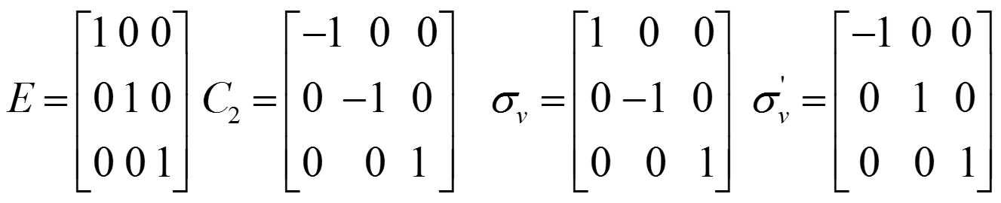
C_{3V} point group
C_{3V} group, the elements are E,C₃,C₃²,σ_{V}’,σ_{V}” and σ_{V}”’.
The three dimensional representations can be written as;
A general matrix is used for representing the Cn operation.
Defining the rotation axis as the Z-axis , the Z- coordinate will be unchanged by any rotation about the Z-axis,

Slide 56

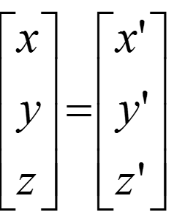
x’= xcosθ - y sinθ +0z
y’ = xsinθ +y cosθ +0z
Z’ = 0x+0y+z
The corresponding matrix product would be,
The general matrix for Cn is

Slide 57

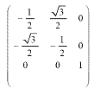
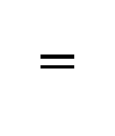
C₃¹
=
=
C₃²

Slide 58
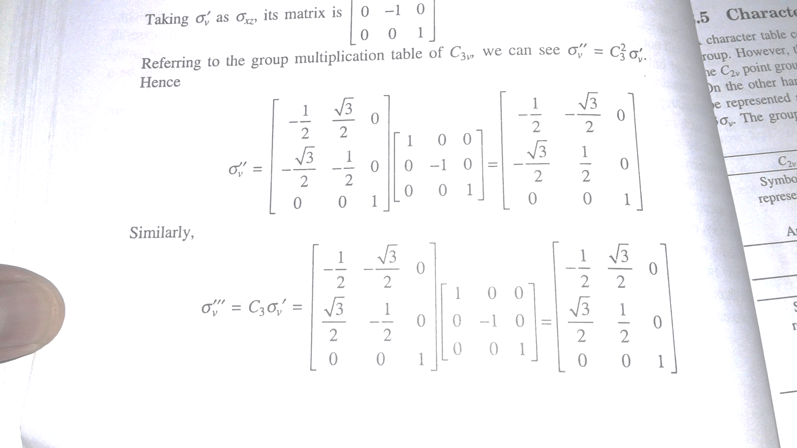
Taking σ_{v}’ as σ_{xz} its matrix is

Slide 59
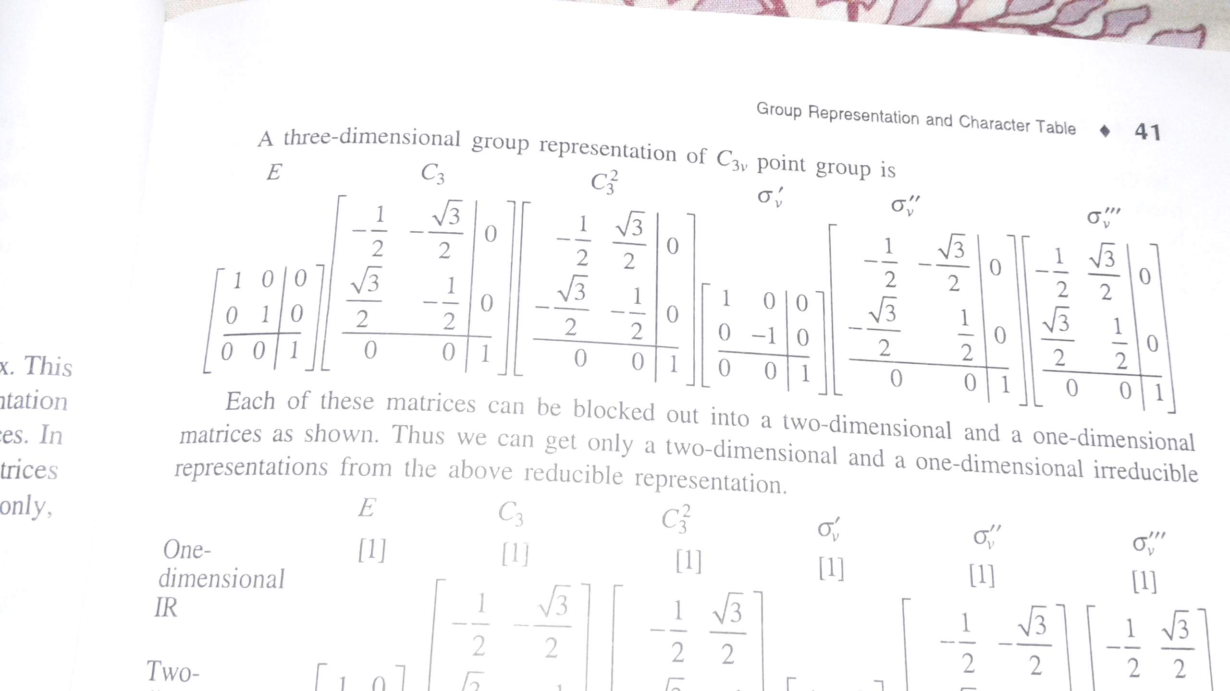

Slide 60
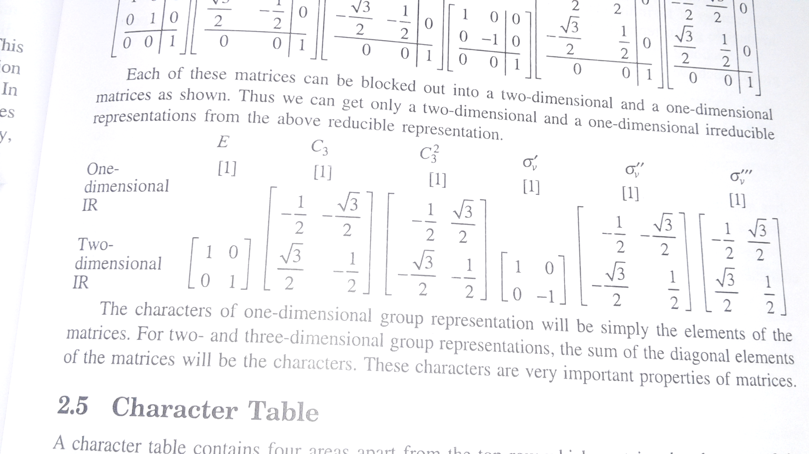

Slide 61
The Great Orthogonality theorem
This theorem concerned with the elements of the matrices constituting the irreducible representations of the group.
All the properties of group representation and their characters are derived from this theorem.
The GOT is
1
If h is the order of the group, l_{i} and l_{j} the dimensions of the i^{th} & j^{th} representation. The δ symbols can have two values 1 or 0 . Thus δ_{ij} = 0 if i # j, and δ_{ij} = 1, if i=j. R indicates the operations of the group.
The element in the m^{th} row and n^{th} column of the matrix corresponding to an operation R in the i^{th} irreducible representation will be denoted as Г_{i}(R_{mn}),
similarly, Г_{j}(R_{m’n’}) , is the element in the m’^{th} row and n’^{th} column of the matrix corresponding to the same operation R in the j^{th} irreducible representation.

Slide 62
The interpretation of the above equation (1) can be done with the help of three
simpler equations. They are ,

Slide 63
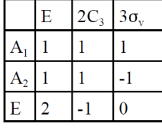
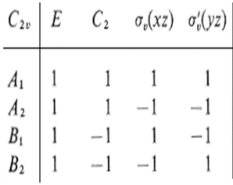
Eg: In C2v point group , four one D irreps are there, So, h = 1² + 1² + 1² + 1² = 4. , here order is 4.
In C3v point group , three irreps, h =1² + 1² + 2² = 6, order is six.
Eg: In C2v point group , first irrep, h = 1² + 1² + 1² + 1² = 4. ,
Or second irrep, h = 1² + 1² + (-1)² + (-1)² = 4, etc..
order is 4 in all cases.
In C3v point group , first irrep, h =1² + 2x1² +3x 1² = 6,
second irrep, h = 1² + 2x1² +3x (-1)² = 6
third irrep, h = 1x2² + 2x(-1)² +3x 0² = 6 . order is six in all cases.

Slide 64
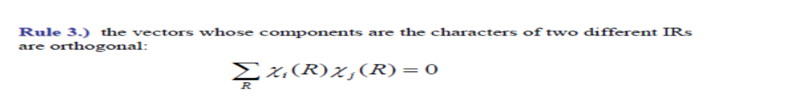
Eg: In C2v point group , Г1 x Г 2 , or A1 x A2 = 1x1 +1x1 +1x-1 + 1x-1 =0, etc….
In C3v point group ,
A1 x E = 1x1x2 + 2x1x-1 + 3x1x0 = 0 , etc….
In C3v point group, C₃¹ and C₃² forms one class and hence they have same characters.
In C3v point group, three irreps and three classes..

Slide 65
Setting up of Character table
GOT rules are used for the construction of character tables.
Mainly four areas are included in the character table.
In Area I are characters of irreducible representations of the group.
Area II is the i^{th} representation, or Mulliken symbols (Г); its meaning is,
One dimensional irreps are denoted by A or B, 2dimensional by E and 3dimensional by T.
One dimensional irreps symmetric χ(C_{n}=1) to principal axis are denoted by A & anti-symmetric χ(C_{n}=-1) to principal axis are represented by B.
Symmetry or anti-symmetry with respect to subsidiary axis (C₂ Ʇ C_{n}) will be denoted by subscripts 1 or 2 respectively. If subsidiary axes are not present, the subscripts 1 or 2 denote symmetry or anti-symmetry with respect to the vertical plane (usually the first σ_{v} in the character table)
Single prime and double prime are used to denote symmetry or anti-symmetry of representations to the horizontal plane.
In groups with centre of inversion, symmetry or antisymmetry with respect to centre of inversion is indicated with the subscripts g or u respectively. (g = gerade, even: u= ungerade, uneven.

Slide 66
Area III of any character table have six symbols: x,y,z, R_{x}, R_{y}, R_{z} . The first three represents coordinates and R’s stands for rotations about the axis denoted by the subscript.

Slide 67
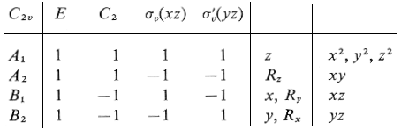
Area IV of the character table are listed all of the squares and binary products of coordinates according to their transformation properties
Character table for C_{2v} point group
Area II
Area I
Area III
Area IV

Slide 68

Character Table for C_{2v} point group
In C_{2v} point group, the elements are, E,C₂,σ_{v} and σ_{v}’ .
Each of these forms a class and thus total four classes.
No of classes = No . of irreps, so 4 irreps are there in C_{2v}.
We know, l₁²+ l₂²+ l₃²+ l₄² = 4,theorder, So l₁ = l₂ = l₃= l₄ = one., all irreps are one dimensional (four one dimensional irreps).
Hence the character of all the identity element is 1.
The sum of the squares of the characters of each irrep is 4, the order of the group. This will possible only if all the characters are 1 or -1.
There can be one irrep with all characters being 1. This is true for every point group and it will given as the first irrep.
The characters of two different irreps should be orthogonal.
Except the first representation, all the other irreps in this group will be such that two operations including E will have 1 as character and the other two will have -1 as the character. Therefore, the character table of C_{2v} is:

Slide 69
In C_{2v} point group, z coordinate transforms as A₁(because no change), x-coordinate transforms as B₁, and the y coordinate as B₂.
The x coordinate is said to transform as B₁, because during the operation E , x remains as such: on C₂ operation, x changes to –x : on σv, x- remains as such and on σv’, x- changes to –x. The corresponding characters are 1,-1,1,-1 . These are the characters of B₁ representation.
And so on…
Consider the transformation of P_{x} orbital. E leaves as such. C₂ operation brings the positive lobe in the place of negative lobe and viceversa, so the character is -1. σv operation the lobes remains as such and on σv’, brings the positive lobe in the place of negative lobe . The characters are 1,-1,1,-1 . These are the characters of B₁ representation. Hence Px transforms to B₁. The Py orbital transforms as B₂ and the Pz to A₁. x,y and z also represents the symmetry of Px,Py and Pz respectively.
S-orbital is spherically symmetrical and transforms to the most symmetric representation in any point group.
-
+

Slide 70
Rx, Ry and Rz in the area III indicate the transformation of the rotational motion of the molecule about x, y and z –axes respectively.
In the C_{2v} point group R_{x} transforms as B₂ and R_{y} as B₁, R_{z} as A₂
Let us find out the characters of Rz. The rotation around the Z-axis represented by the curved arrow,
The arrow is unaffected during E and also C₂
When σv, operates on the arrow, left side of the arrow moves to the
right side and vice-versa. This reverses the direction and arrow. Hence character
is -1.
For σv’ also the direction reverses and character is -1.
i.e, 1, 1,-1,-1. , corresponds to A₂.
And so on….
Z
Y
X

Slide 71
Character table for C_{3v} point group
In the C_{3V} group, the elements are
E,C₃,C₃²,σ_{V}’,σ_{V}” and σ_{V}”’.
Total no. class = 3, which is equivalent to total no. of irreps.
l₁²+ l₂²+ l₃² = 6 ,the order, So l₁ =1 ,l₂₌ 1 l₃= 2. So one two D irrep and two one D irrep.
The elements can be represented in three classes as, E, 2C₃ and 3σ_{V.}
There will be one totally symmetrical one dimensional representation in all character tables.
So
From GOT, 1² +2a² +3b² =6
From orthogonality rule, 1x1x1 + 2x1xa + 3x1xb = 0
1+2a + 3b =0
Solving these two equations yields b=-1 and a =1.
Then take , orthogonality of Г1 and Г3 yield 2+ 2c +3d=0. of Г2 and Г3 yields 2+2c-3d =0, So c=-1and d=0. So the complete character table is ,

Slide 72
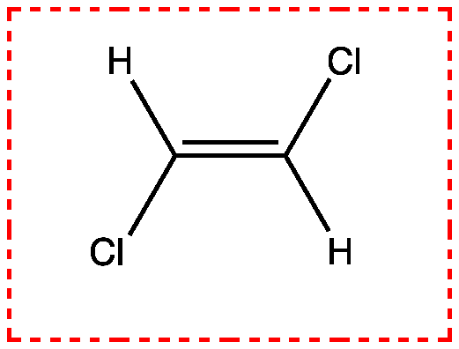
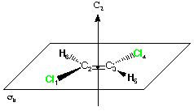
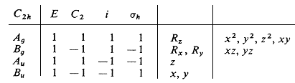
Character table for C_{2h} point group
In C_{2h} point group, the elements are, E,C₂,i and σ_{h} .
Each of these forms a class and thus total four classes.
No of classes = No . Of irreps, so 4 irreps are there in C_{2h}.
We know, l₁²+ l₂²+ l₃²+ l₄² = 4,the order, So l₁ = l₂₌ l₃₌ l₄ = one., all irreps are one dimensional (four one dimensional irreps).
Hence the character of all the identity element is 1.
The sum of the squares of the characters of each irrep is 4, the
order of the group. This will possible only if all the characters
are 1 or -1.
There can be one irrep with all characters being 1. This is
true for every point group and it will given as the first irrep.
The characters of two different irreps should be orthogonal.
Except the first representation, all the other irreps in this group will be such that two operations including E will have 1 as character and the other two will have -1 as the character. Therefore, the character table of C_{2h} is:

Slide 73
Reducible representations
The representations obtained in group theory as per vector basis may be reducible or irreducible.
If we are getting an irreducible representation, that will look like any of the irreducible representations already present in the character table.
There will not be a representation in the character table as that we have obtained, it is a reducible representation.
Reducible representations are the sum of certain set of irreducible representations.
We can determine the number of times each of the irreps occurring in a reducible representations by using the reduction formula which can be derived from GOT.
h is the order, g(R) is the number of conjugate elements in the class of the element R. χ_{i}(R) is the character of the operation R in the i^{th} irreducible representation and χ(R) is the total character.

Slide 74
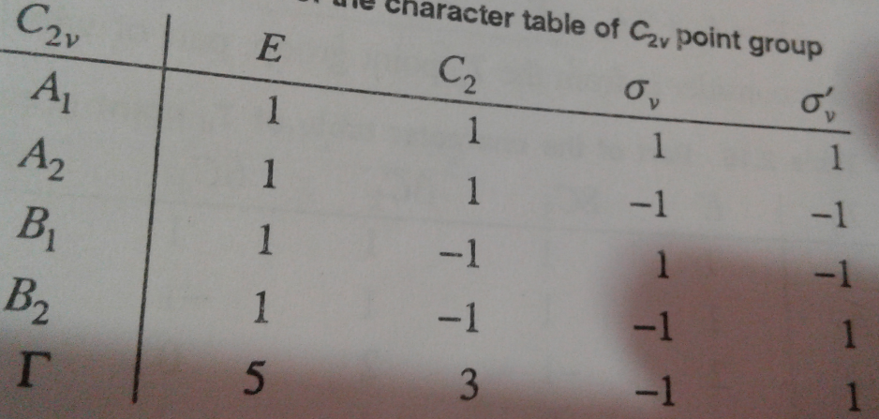
In C2v point group , each element forms a class and hence g(R) = 1 for all operations.
In C3v point group, g(E)=1, g(C₃) =2, and g(σ_{v}) = 3.
Reduction formula of C_{2v}

Slide 75
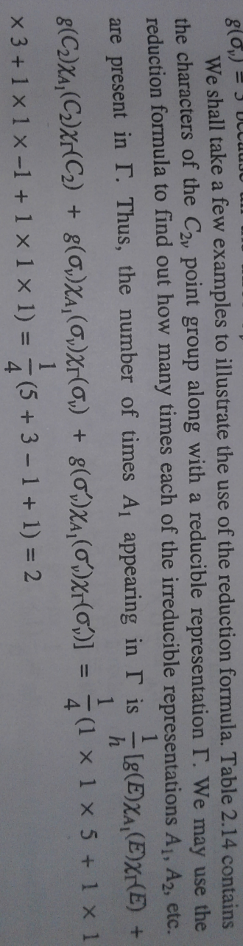
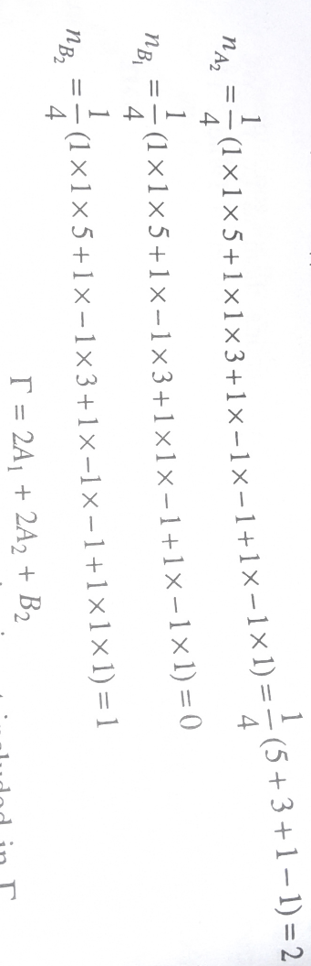
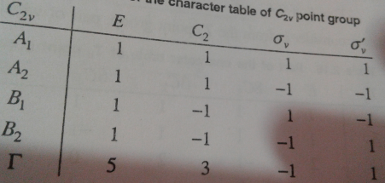

Slide 76
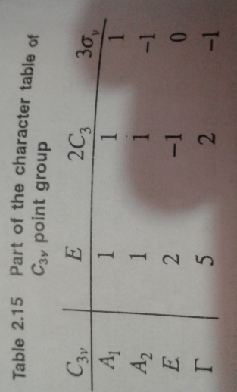
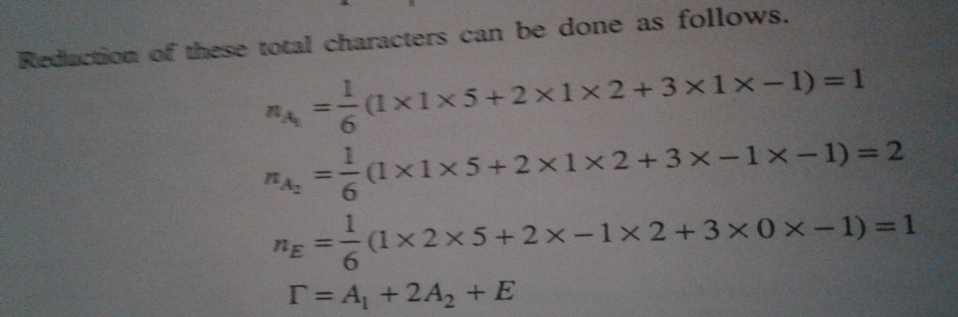
Reduction formula of C_{3v}
Q. Reduce the following representation using the
character table.
C_{3v} | E 2C₃ 3σ_{v}
Γ | 5 2 -1

Slide 77
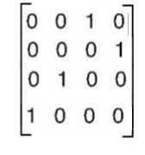
Hybridisation
r₁
Td point group
r₂
r₄
In Td, the symmetry elements are, E, C₃, C₂ , S₄, σ_{d}
We have to find-out the characters by taking these vectors as basis. χ (E) = 4
r₃
E =
χ (E) = 4
C₃ =
χ (C₃) = 1
=
C₂ =
S₄ =
χ (S₄) = 0
χ (C₂) = 0
σ_{d} =
χ (σ_{d}) = 2
r₁ to r₄, r₂ to r₃,
r₃ to r₁ & r₄ to r₂
So the characters are , 4 1 0 0 2

Slide 78
Character table for Td
Г is not an irreducible representation. But it is reducible and we are reducing it using the reduction formula.
n_{A1} = 1/24 [ 1x1x4 + 8x1x1 + 3x1x0 +6 x1x0 + 6x1x2 = 1/24[4+8+0+0+12] = 1/24[24] =1
n_{A2} = 1/24 [1x1x4 + 8x1x1 + 3x1x0 +6 x-1x0 + 6x-1x2 = 1/24[4+8+0+0-12] = 1/24[0] = 0
n_{E} = 1/24[1x2x4 + 8x-1x1 + 3x2x0 +6 x0x0 + 6x0x2 = 1/24[8-8+0+0+0] = 1/24[0] = 0
n_{T1} = 1/24[1x3x4 + 8x0x1 + 3x-1x0 +6 x1x0 + 6x-1x2 = 1/24[12 +0+0+0-12] = 1/24[0] = 0
n_{T2} = 1/24[1x3x4 + 8x0x1 +3x-1x0 +6 x-1x0 +6x1x2 = 1/24[12+0 +0 +0 +12] = 1/24[24] = 1

Slide 79
Therefore, Г = A₁ + T₂
This means that one of the hybrid orbitals has A1 symmetry and other three have T2 symmetry. The atomic orbitals having these symmetries can be identified from the character table.
S-orbitals are totally symmetric.
In the Td point group, S- orbitals transforms to A₁.
The Px,Py, Pz and dxy,dyz, dxz transforms to T₂ symmetry.
A set of four tetrahedral orbitals may be formed from one S- and three P or one S and three d orbitals.
sp³ or d³s hybridisation is possible.
In CH₄ sp³ hybridisation is involved.
But in [MnO₄]⁻ and [CrO₄]²⁻ d³s hybridisation is involved using 3d and 4s orbitals.

Slide 80
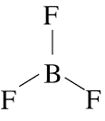
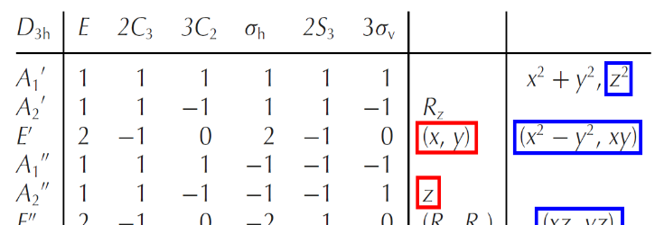
Triangular Planar , AB₃ type . D_{3h} point group.
The operations are
The characters are
n_{A1} = 1/12 [ 1x1x3 + 2x1x0 + 3x1x1 +1 x1x3 + 2x1x0 +3x1x1 = 1/12[3+0+3+3+0+3] = 1/12[12] =1
nE’ = 1
Remaining irreps give 0 value.

Slide 81
Г = A1’ + E’
The hybridised orbitals have symmetries A1’ and E’ .
Atomic orbitals having these symmetries alone can hybridise to give hybrid orbitals.
The corresponding orbitals are,
A1’ = S or dz²
E’ = px and py
or
dx²-y² and dxy
The four possible combinations are,
            s+px+py = sp²
            s+ dx²-y² +dxy = d²s
            dz² +px+py = p²d
            dz² +dx²-y² +dxy = d³
            All these four hybridisations can give rise to triangular planar belongs to D3h point group.

Slide 82
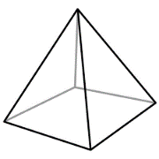
Square pyramidal , AB₅ type , C_{4v} point group.
2A1 = S , Pz dz²
B1 = dx²-y²
E = Px and Py
or
dxz and dyz
Г = 2A1 + B1 + E
Possible hybridisations are,
S + Pz + Px + Py + dx²-y² = dsp³
S + Pz + dx²-y² + dxz +dyz = d³SP
S + dz²+ dx²-y² + Px + Py = d²SP²
n_{A1} = 1/8 [1x1x5 + 2x1x1 + 1x1x1+ 2x1x3+ 2x1x1 ]
= 1/8[5+2+1+6+2]= 16/8 =2
nB1 = 1
nE = 1
Remaining are zero.

Slide 83
Trigonal bipyramidal , AB₅ type , D_{3h} point group.
Г = 2A1’ + E’+A2’’
The corresponding orbitals are,
A1’ = S or dz²
E’ = px and py
or
dx²-y² and dxy
A2’’ = pz
dsp³ or d³sp are the possible hybridisation.
n_{A1’} = 1/12 [1x1x5 + 2x1x2 + 3x1x1+ 1x1x3+ 2x1x0 +3x1x3 ]
= 1/12[5+4+3+3+0+9]= 24/12 =2
nE’ = 1
nA2’’ = 1
Remaining are zero.

Slide 84
Square Planar, AB₄ type , D_{4h} point group.
A1g = S , dz²
B1g = dx²-y²
Eu = Px and Py
n_{A1g} = 1/16 [1x1x4 + 2x1x0 + 1x1x0+ 2x1x2+ 2x1x0+ 1x1x0+ 2x1x0+ 1x1x4+2x1x2+2x1x0]
= 1/16[4+0+0+4 +0+0+0+4+4+0] =16/16 =1
nB1g = 1
nEu = 1
A1g+B1g +Eu
Hybridisations
dsp² and d²p²

Slide 85

Direct Products.
It is often necessary to determine the symmetry of the product of two irreps, i.e., to
determine their direct product.
The representation of the product of two representations is given by the
product of the characters of the two representations.
Verify that under C2v symmetry A2 x B1 = B2
A2 ⊗ B1 1 -1 -1 1
As can be seen above, the characters of A2 ⊗ B1 are those of the B2 irrep.

