Slide 1
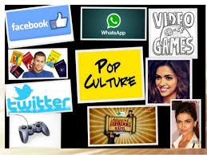
Popular Culture

Slide 2
Popular Culture
Prepared by:
Jolly Alex
Assistant Professor
Dept. of English
Christian College, Chengannur.
(MA English- Cultural Studies)

Slide 3
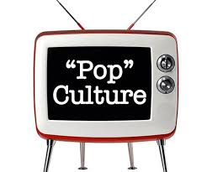
What is Popular Culture?
Popular Culture is people’s culture
Also known as Pop Culture
Culture of masses
Influenced by mass media

Slide 4
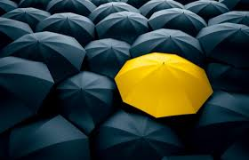
Why is it Unique?
It is constantly changing
It is specific to time and place

Slide 5
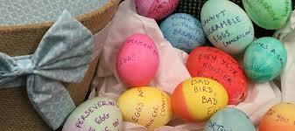
Forms of Popular Culture
Music
Television
Sports
Toys
Comics
Film advertising
Fashion
Magazine

Slide 6
Issues in Popular Culture
Race
Ethnicity
Gender
Sexuality
Cultural Imperialism
Censorship

Slide 7
Categories of Popular Culture
Entertainment
Sports
News
Politics
Fashion
Technology

Slide 8
1. Entertainment

Slide 9
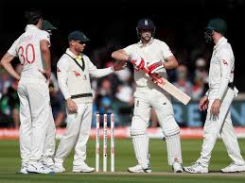
2. Sports

Slide 10
3. News

Slide 11
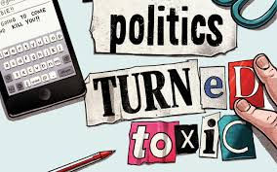
4. Politics

Slide 12
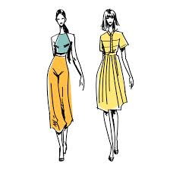
5. Fashion

Slide 13
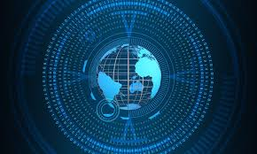
6. Technology

Slide 14
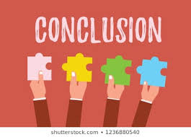
Conclusion
Each one has his own Pop culture menu

