Slide 1
Early Development of Quantum Mechanics
Dr. Prinson P Samuel
Department of Chemistry
Christian College Chengannur

Slide 2
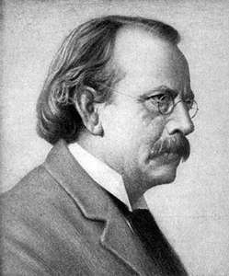
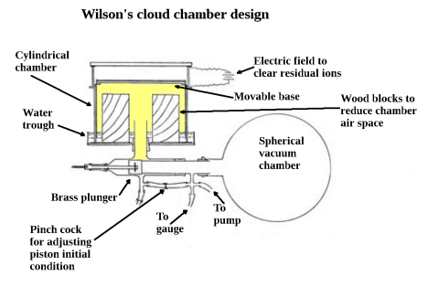
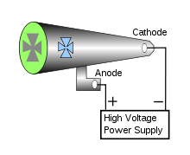
Early development of quantum mechanics
1897
JJ Thomson discovered electron
Crooke’s Tube

Slide 3
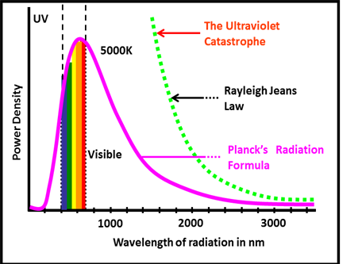
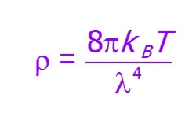
Early development of quantum mechanics
Blackbody radiation could not be explained by classical physics
Rayleigh-Jeans Law

Slide 4
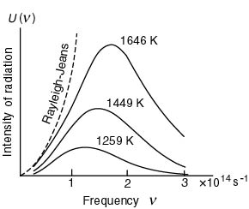
Early development of quantum mechanics
Paradox
Cannot explain the wavelenght dependence of the intensity (I) of the light that is emitted from a simple heated object (an idealized “black body” that absorbs all light)!
I (Intensity) proportional to ν
I (Intensity) proportional to λ
I (Intensity)goes to infinity as λ goes to zero!
Experiment: Maximum observed!

Slide 5
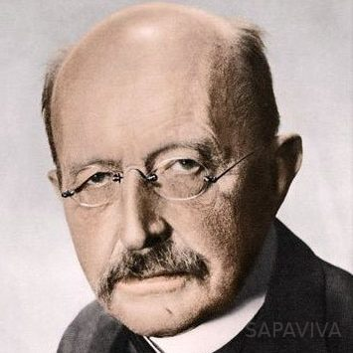
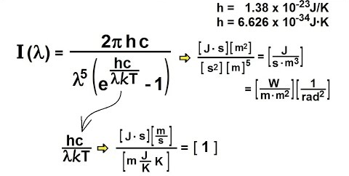
Early development of quantum mechanics
1900
Max Planck used a quantum hypothesis to derive the blackbody radiation law
Max Planck
Nobel Prize 1918
“for his explanation of the ultraviolet catastrophe”, namely E = hν.

Slide 6
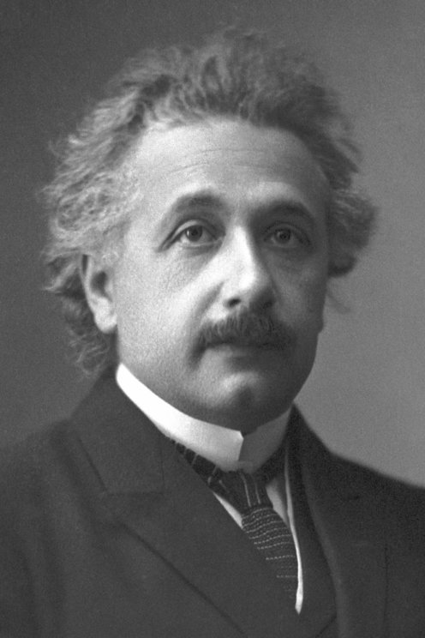
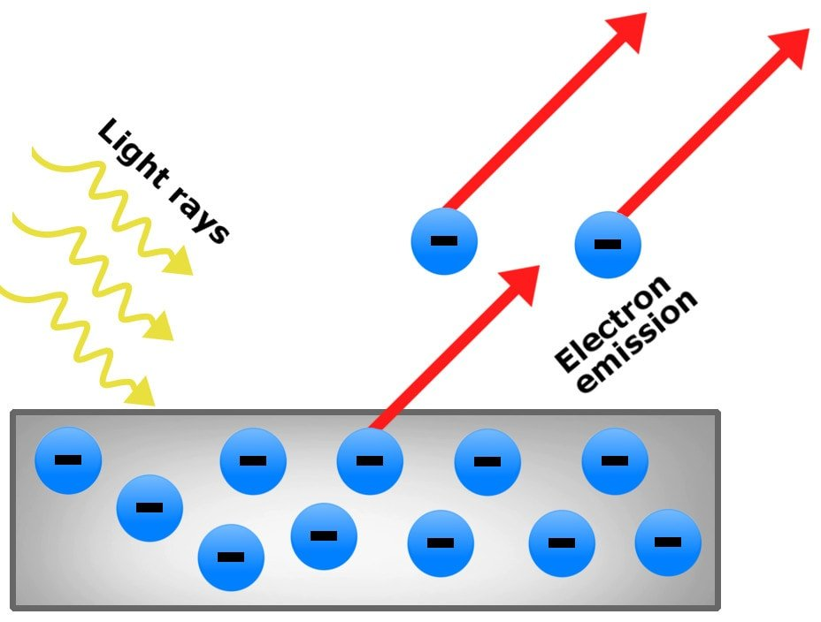
Early development of quantum mechanics
1905
Einstein explained photoelectric effect with a quantum hypothesis
A beam of light hitting a metal surface can cause electrons to be ejected from the surface.
Classical Paradigm: the energy of the ejected electrons should be proportional to the intensity of the light and independent of the frequency of the light.
Experiment: the energy of the ejected electrons is independent of the intensity and depends directly on the frequency.

Slide 7
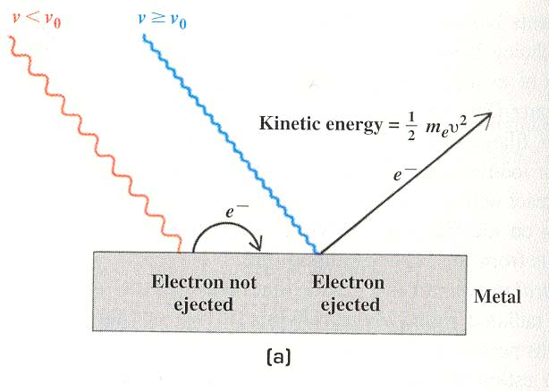
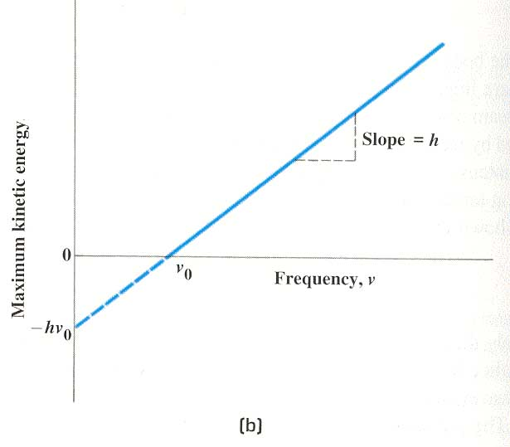
Early development of quantum mechanics
Blue light
kicks out
electrons!
Red light
is “inert”
to kicking
out electrons
E₂ - E₁ = hν
Albert Einstein
Nobel Prize 1921
“For his explanation of the photoelectric effect”, namely,
E₂ - E₁ = hν, light is
quantized as photons.
The slope of KE_{Max} vs ν is h!!!!!

Slide 8
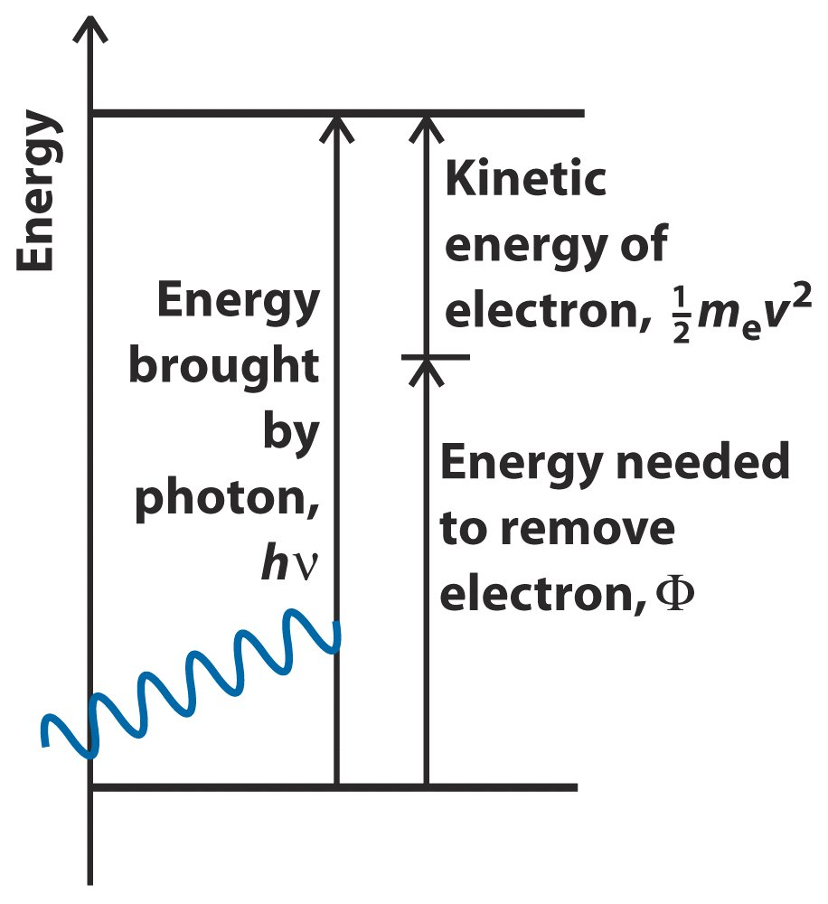
Early development of quantum mechanics

Slide 9
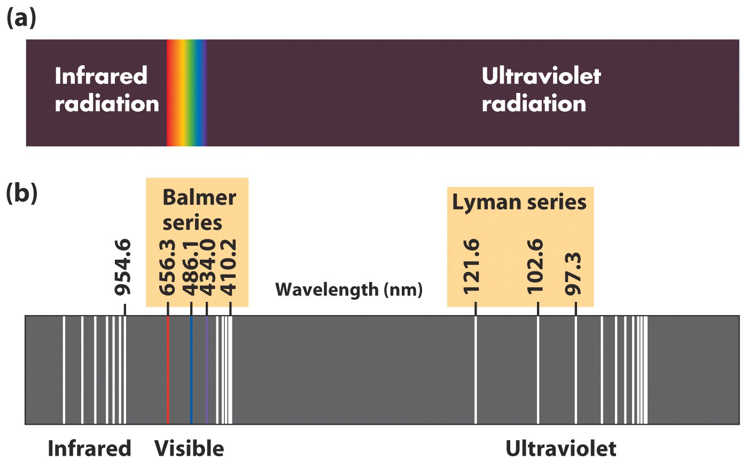
Early development of quantum mechanics
Rydberg equation explained the relation between spectral lines of hydrogen but lacked theoretical support

Slide 10
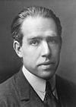
Early development of quantum mechanics
1913
Bohr introduced an atom model based on the concept of angular momentum quantization
Light is emitted when an electron jumps from a higher orbit to a lower orbit and absorbed when it jumps from a lower to higher orbit.
The energy and frequency of light emitted or absorbed is given by the difference between the two orbit energies, e.g.,
E(photon) = E₂ - E₁ (Energy difference)
The basis of spectroscopy!!!

Slide 11

Early development of quantum mechanics
E₄
E₄
E₃
E₃
E₂ - E₁ = hν
E₅
E₂
E₅
E₂
E₁
E₁
Photon
absorbed
Photon
emitted
E₂ - E₁ E₂ - E₁ E₂ - E₁ E₂ - E₁
Bohr atom: Light absorption occurs when an electron absorbs a photon and makes a transition for a lower energy orbital to a higher energy orbital. Absorption spectra appear as sharp lines.
Bohr atom: Light emission occurs when an electron makes a transition from a higher energy orbital to a lower energy orbital and a photon is emitted. Emission spectra appear as sharp lines.

Slide 12
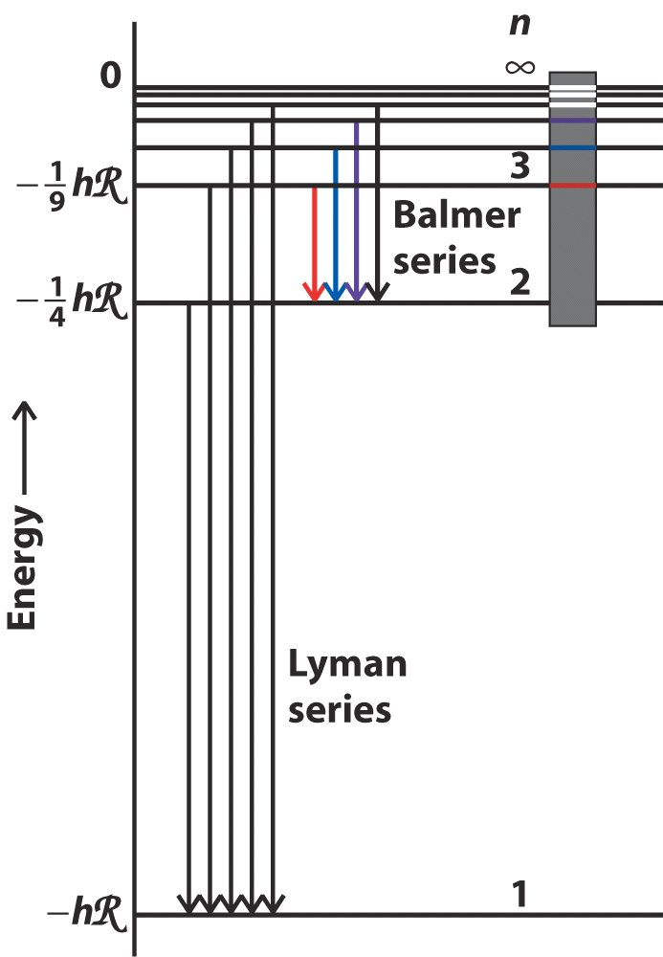
Early development of quantum mechanics
Gave theoretical support to Rydberg equation
Niels Bohr won the Nobel Prize 1922 for “the structure of atoms and the radiation emanating from them”

Slide 13
Early development of quantum mechanics
Quantization is a highly manifested phenomenon in the microscopic domain

Slide 14
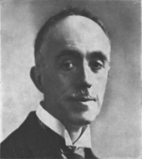
Early development of quantum mechanics
If waves can mimic particles, then particles can mimic waves
Light: E = hν (Planck)
Mass: E = mc² (Einstein)
then
hν = h(c/λ) = mc² (de Broglie)
Light = Matter
Louis de Broglie 1892-1987
Nobel Prize 1929
“for his discovery of the wave
nature of electrons”
“Two seemingly incompatible conceptions can each represent an aspect of the truth ... They may serve in turn to represent the facts without ever entering into direct conflict.” de Broglie, Dialectica

Slide 15
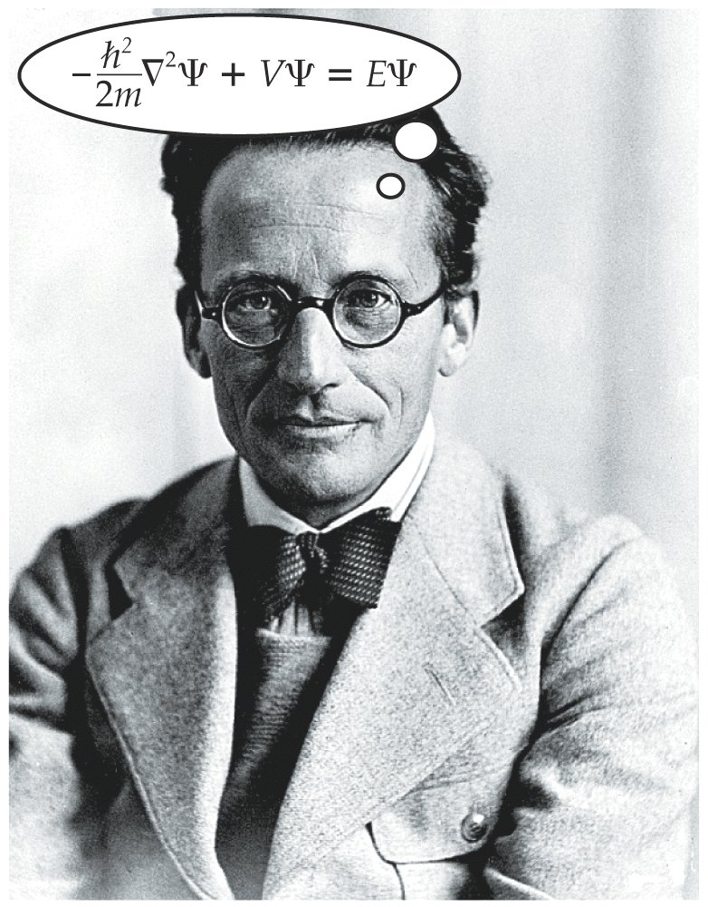
Early development of quantum mechanics
Schroedinger: If electrons are waves, their postion and motion in space must obey a wave equation.
Solutions of wave equations yield wavefunctions, Y, which contain the information required to describe ALL of the properties of the wave.

Slide 16
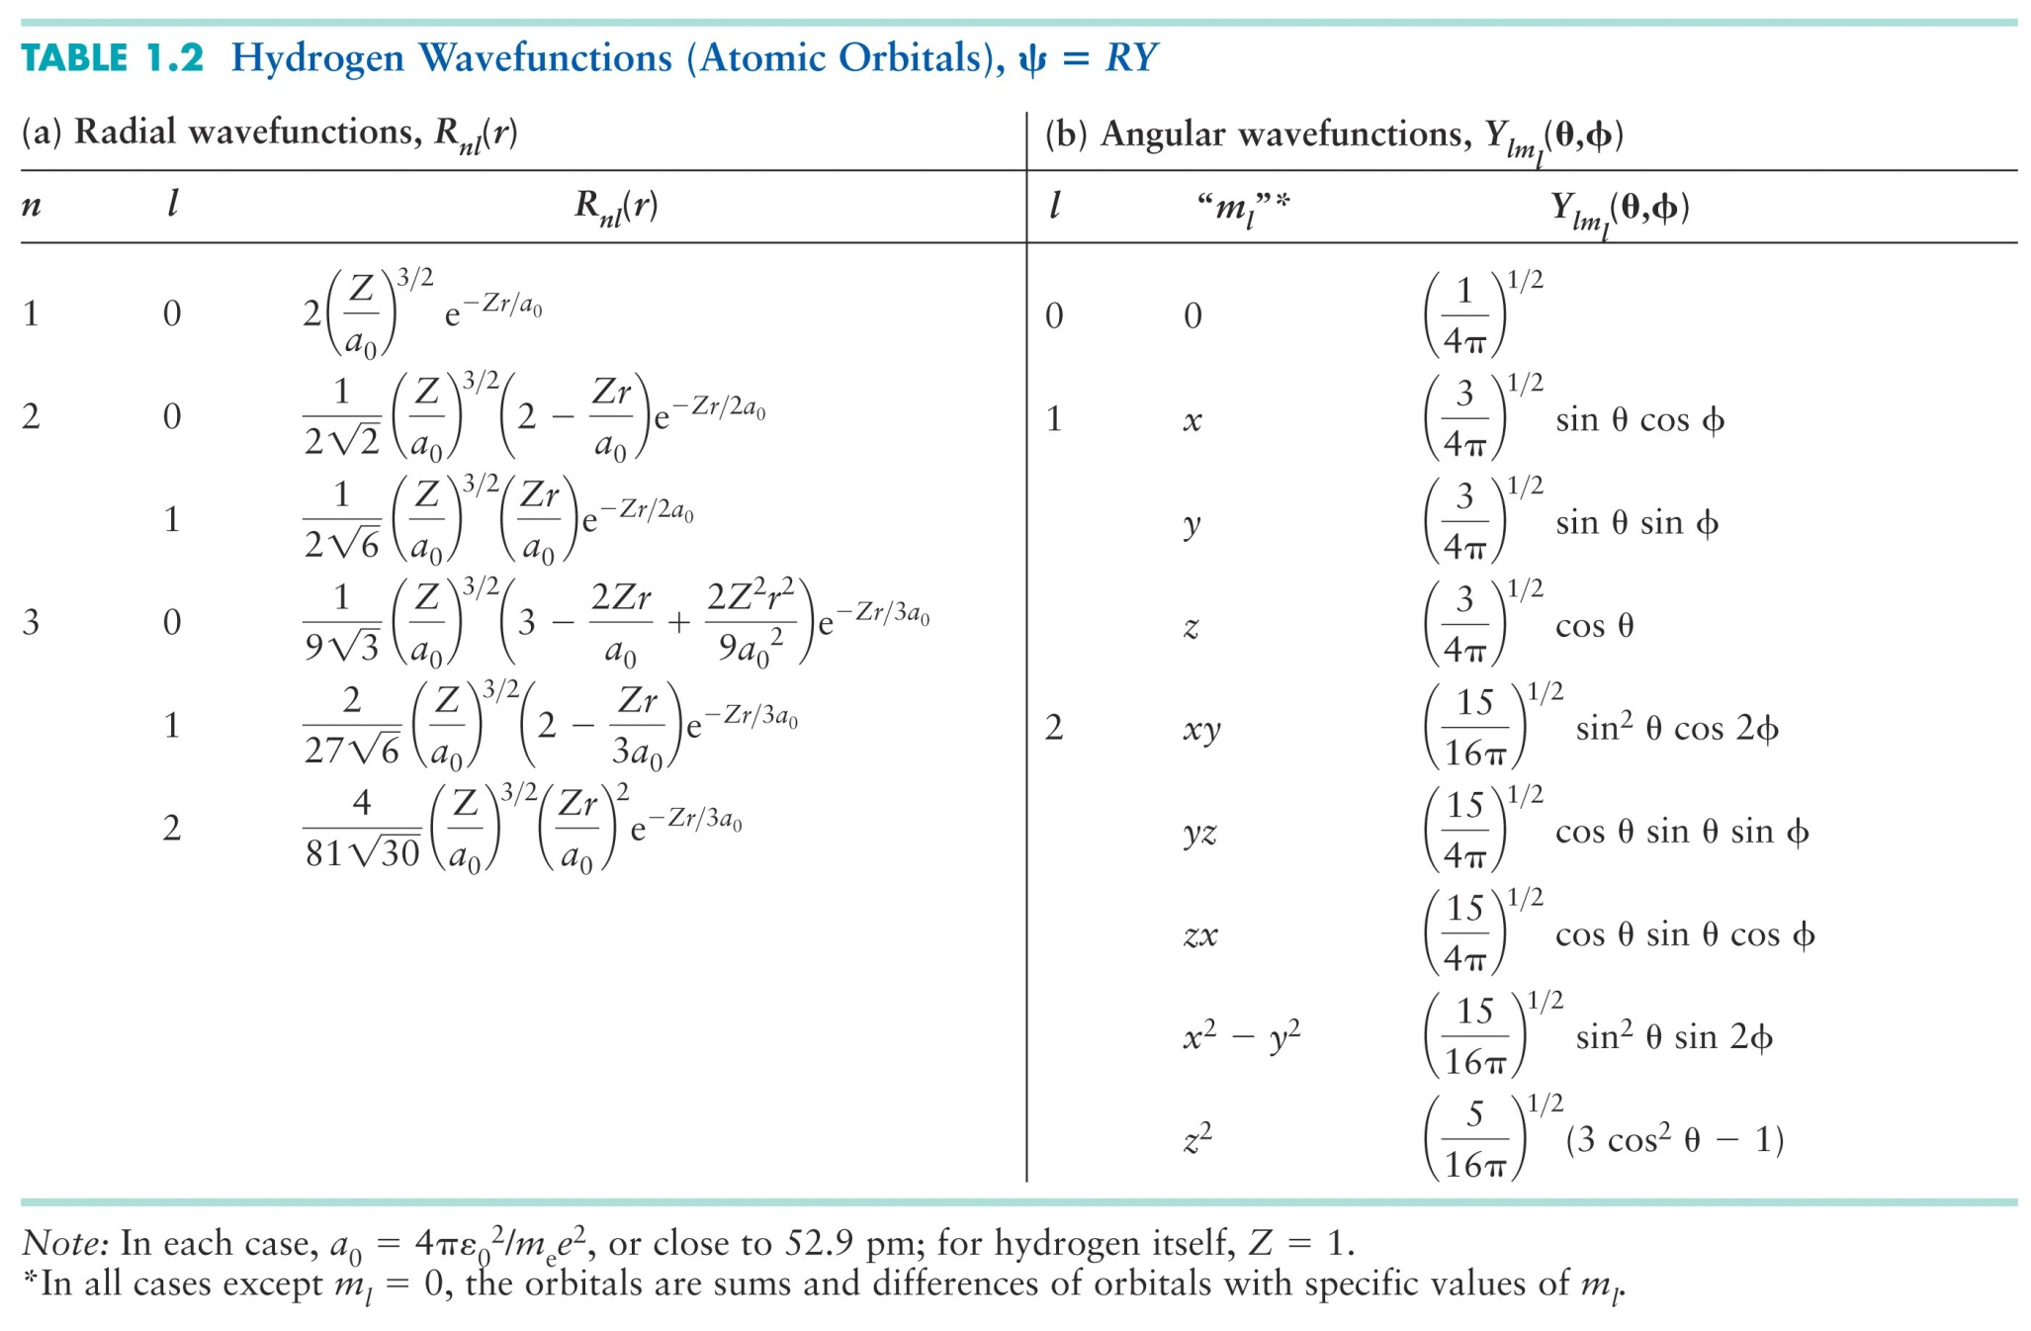
Early development of quantum mechanics
Hydrogen orbital wave functions

Slide 17
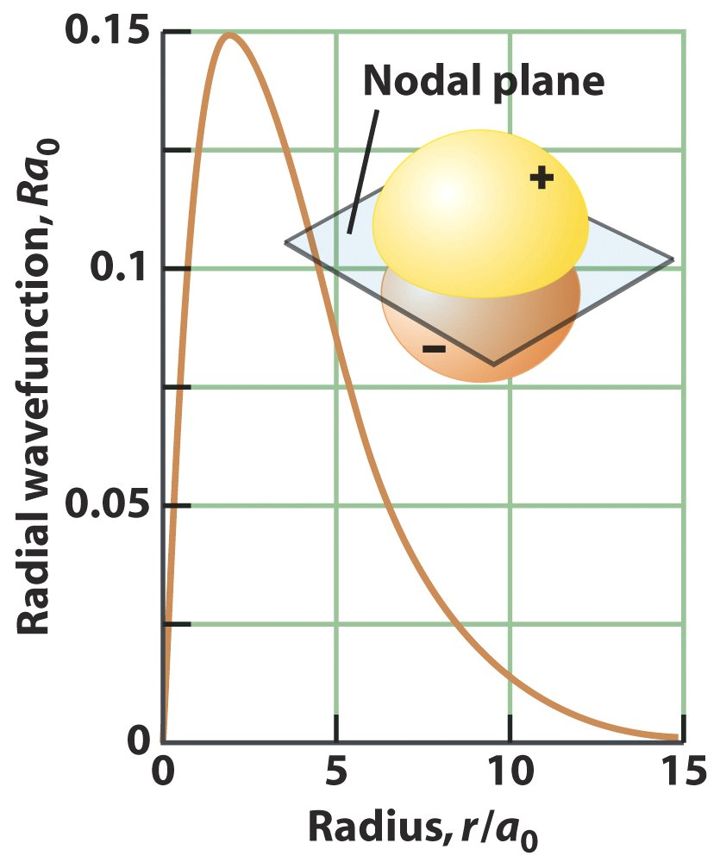
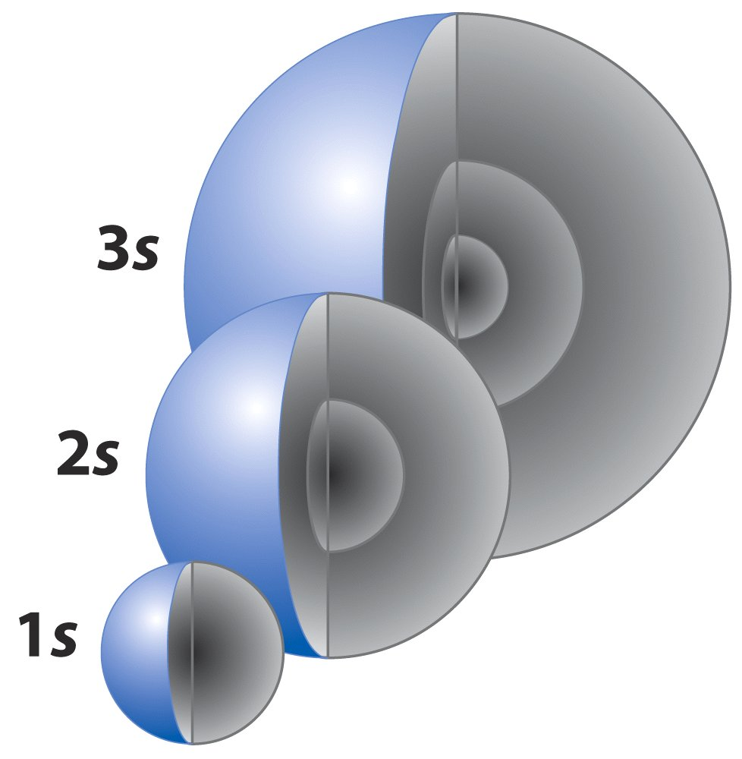
Early development of quantum mechanics
Pictures of Wave functions: Orbitals

Slide 18

Early development of quantum mechanics
When I visited the grave of Max Planck in Göttingen.
Thank You

